Slide 1
One Dimensional Study of MPD Thrusters for a Potential New Class of Heavy Ion Drivers for PJMIF
Patrick M. Brown
14 May 2021
Thesis Defense

Slide 2
Outline
Research Goals
PJMIF Process
MPD Thruster Theory
Steady State and Conservative MHD Equations
Numerically Solving MHD Equations
Steady-State Results
Time-Dependent Results
Conclusions
Future Work

Slide 3
Research Goals
Provide 1D studies of low powered MPD thrusters.
Examine the effects of the applied current density within the MPD thrusters on the final axial velocity of the plasma and the expansion of the plasma density within the MPD chamber.
Analyze the effects of an applied solenoidal magnetic field within the MPD thruster on the axial and azimuthal components of the velocity.
Study the effects the plasma number density has on the plasma motion and final plasma velocity.

Slide 4
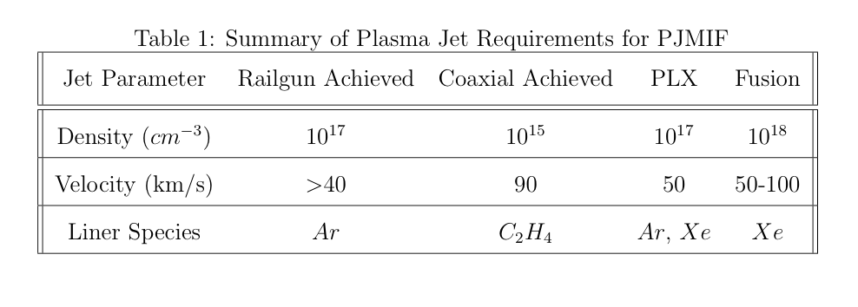
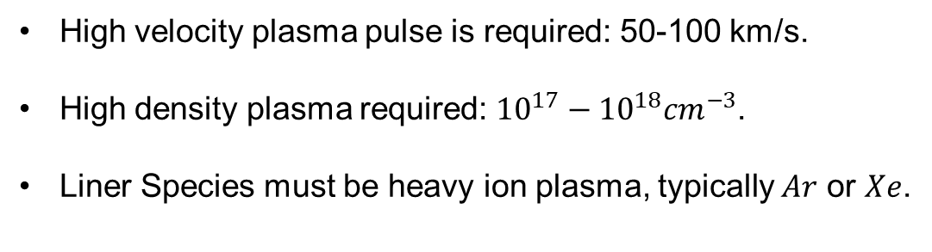
Plasma Driver Requirements
High velocity plasma pulse is required: 50-100 km/s.
High density plasma required: ${10}^{17}−{10}^{18}{cm}^{−3}$.
Liner Species must be heavy ion plasma, typically $Ar$ or $Xe$.

Slide 5
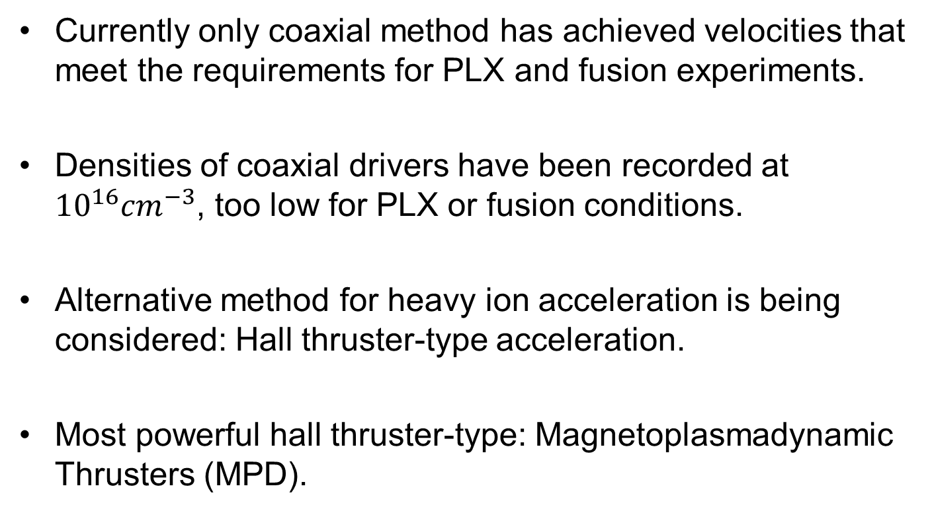
Heavy Ion Drivers
Currently only coaxial method has achieved velocities that meet the requirements for PLX and fusion experiments.
Densities of coaxial drivers have been recorded at ${10}^{16}{cm}^{−3}$, too low for PLX or fusion conditions.
Alternative method for heavy ion acceleration is being considered: Hall thruster-type acceleration.
Most powerful hall thruster-type: Magnetoplasmadynamic Thrusters (MPD).

Slide 6
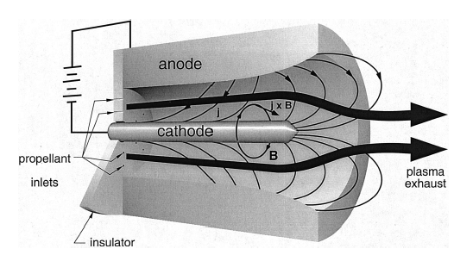
MPD Thrusters
Basic MPD Layout
Composed of a cathode placed at the center of the thruster axis and an anode that forms the outer wall of the thruster.
Electrons flow from the cathode to the anode, forming a current density that flows back from the anode to the cathode.
Two types of MPD: Self-field MPD and Applied Field MPD.

Slide 7
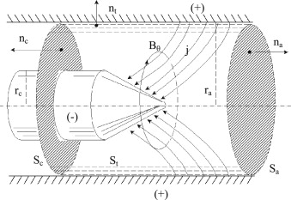
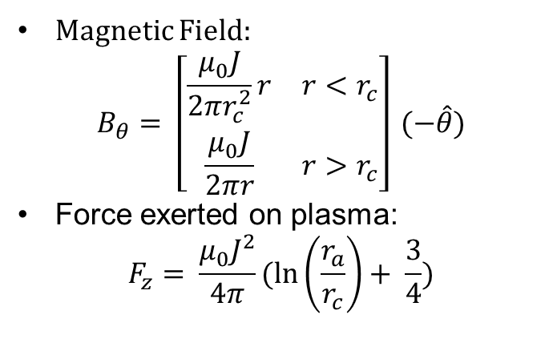
Self-field MPD
Magnetic Field:
$$B_{θ}= \left[\begin{matrix}\frac{μ_{0}J}{2πr_{c}^{2}}r & r<r_{c} \\ \frac{μ_{0}J}{2πr} & r>r_{c}\end{matrix}\right] (−\hat{θ})$$
Force exerted on plasma:
$$F_{z}= \frac{μ_{0}J^{2}}{4π}(\ln\left(\frac{r_{a}}{r_{c}}\right)+ \frac{3}{4})$$
Integrating Surfaces of Self-field MPD Thruster

Slide 8
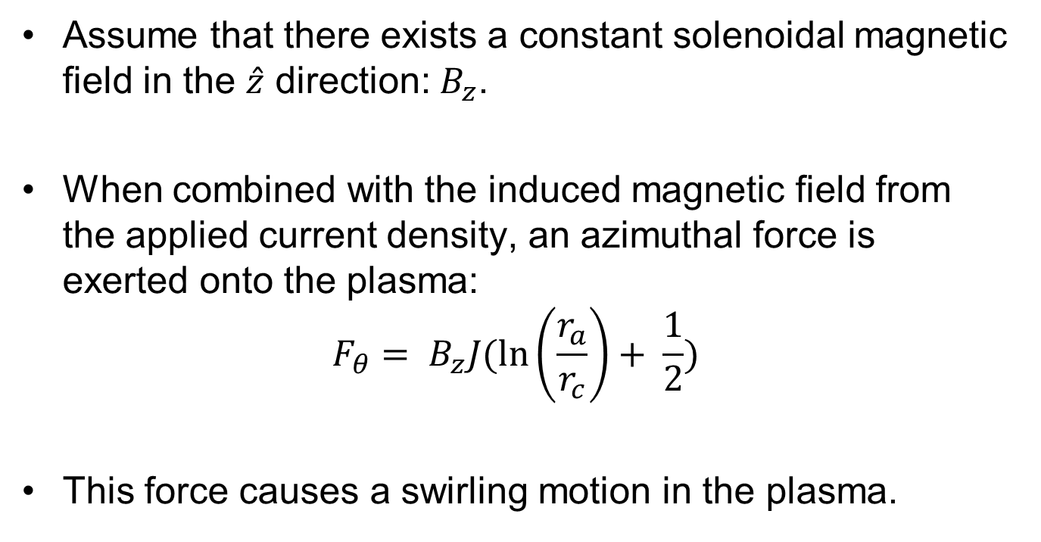
Applied Field MPD’s
Assume that there exists a constant solenoidal magnetic field in the $\hat{z}$ direction: $B_{z}$.
When combined with the induced magnetic field from the applied current density, an azimuthal force is exerted onto the plasma:
$$F_{θ}= B_{z}J(\ln\left(\frac{r_{a}}{r_{c}}\right)+ \frac{1}{2})$$
This force causes a swirling motion in the plasma.

Slide 9
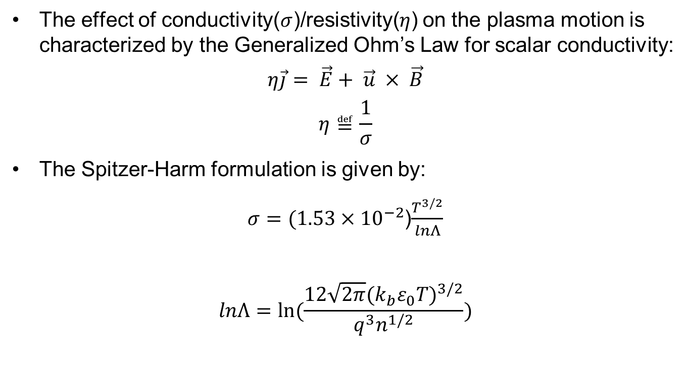
Conductivity/Resistivity
The effect of conductivity($σ$)/resistivity($η$) on the plasma motion is characterized by the Generalized Ohm’s Law for scalar conductivity:
$$η\vec{j}= \vec{E}+ \vec{u} × \vec{B}$$
$$η≝\frac{1}{σ}$$
The Spitzer-Harm formulation is given by:
$σ=(1.53×{10}^{−2}$)$\frac{T^{3/2}}{lnΛ}$
$$lnΛ=ln⁡(\frac{12\sqrt{2π}(k_{b}ε_{0}T)^{3/2}}{q^{3}n^{1/2}})$$

Slide 10
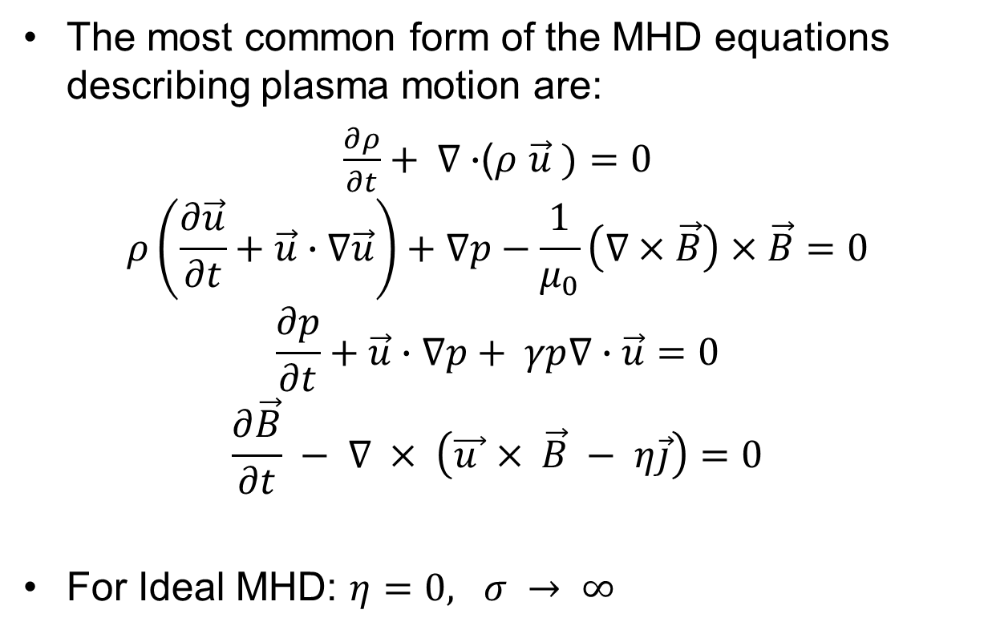
MHD Equations
The most common form of the MHD equations describing plasma motion are:
$\frac{∂ρ}{∂t}+ ∇∙$($ρ$ $\vec{u} )=0$
$$ρ\left(\frac{∂\vec{u}}{∂t}+\vec{u}∙∇\vec{u}\right)+∇p−\frac{1}{μ_{0}}\left(∇×\vec{B}\right)×\vec{B}=0$$
$$\frac{∂p}{∂t}+\vec{u}∙∇p+ γp∇∙\vec{u}=0$$
$$\frac{∂\vec{B}}{∂t} − ∇ × \left(\vec{u }× \vec{B} − η\vec{j}\right)=0$$
For Ideal MHD: $η=0, σ → ∞$

Slide 11
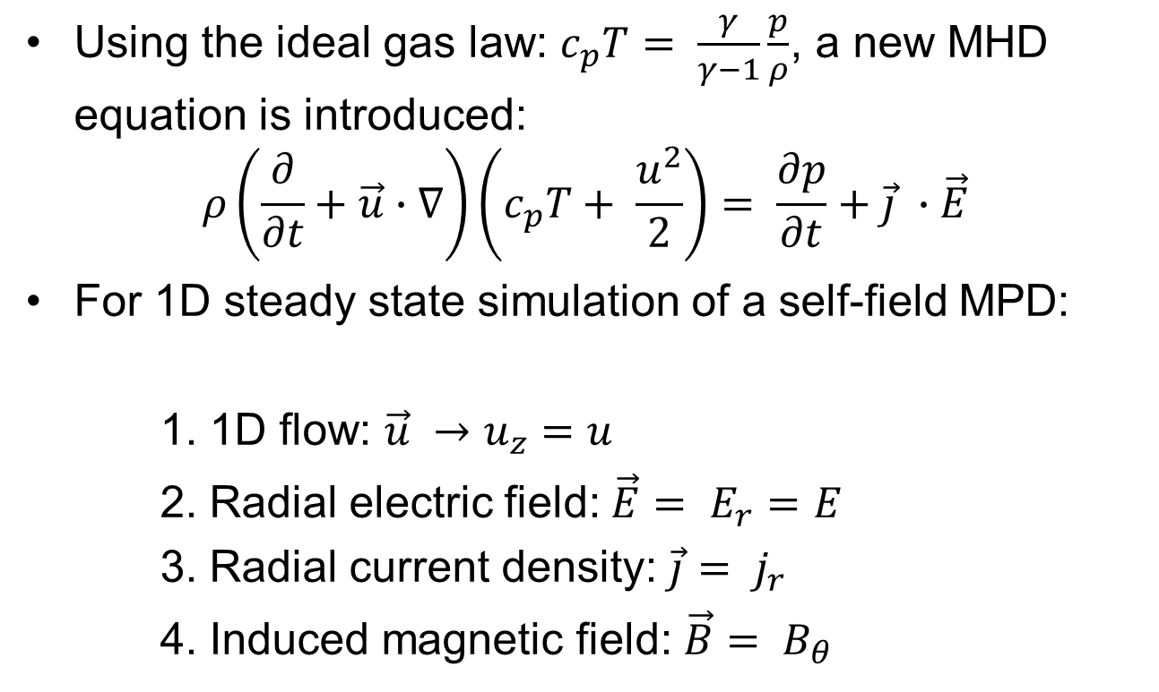
Steady-State MHD Equations
Using the ideal gas law: $c_{p}T= \frac{γ}{γ−1}\frac{p}{ρ}$, a new MHD equation is introduced:
$$ρ\left(\frac{∂}{∂t}+\vec{u}∙∇\right)\left(c_{p}T+ \frac{u^{2}}{2}\right)= \frac{∂p}{∂t}+\vec{j} ∙\vec{E}$$
For 1D steady state simulation of a self-field MPD:
1. 1D flow: $\vec{u} →u_{z}=u$
2. Radial electric field: $\vec{E}= E_{r}=E$
3. Radial current density: $\vec{j}= j_{r}$
4. Induced magnetic field: $\vec{B}= B_{θ}$

Slide 12
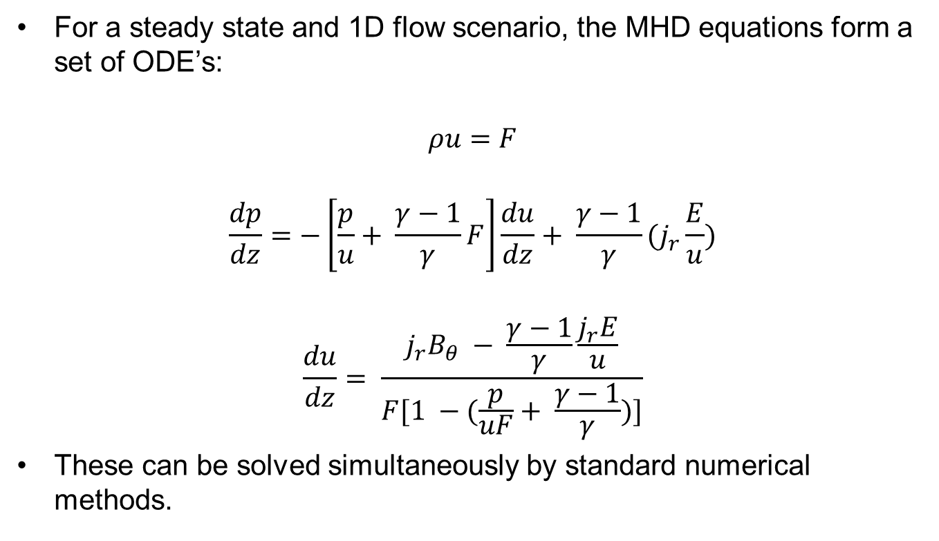
Steady-State MHD Equations
For a steady state and 1D flow scenario, the MHD equations form a set of ODE’s:
$$ρu=F$$
$$\frac{dp}{dz}=−\left[\frac{p}{u}+ \frac{γ−1}{γ}F\right]\frac{du}{dz}+ \frac{γ−1}{γ}(j_{r}\frac{E}{u})$$
$$\frac{du}{dz}= \frac{j_{r}B_{θ} − \frac{γ−1}{γ}\frac{j_{r}E}{u}}{F[1 −(\frac{p}{uF}+ \frac{γ−1}{γ})]}$$
These can be solved simultaneously by standard numerical methods.

Slide 13

Conservative, Ideal MHD Equations
The conservative form of the MHD equations is given by:
$$\frac{∂ρ}{∂t}+ ∇∙\text{(}ρ \vec{u} )=0$$
$$\frac{∂ρ\vec{u}}{∂t}+ ∇∙\left(ρ\vec{u}\vec{u}+ p_{T}\hat{I} −\vec{B}\vec{B}\right)=0$$
$$\frac{∂e}{∂t}+ ∇∙\left(\left(e+ p_{T}\right)\vec{u} −\left(\vec{u} ∙\vec{B}\right)∙\vec{B}\right)=0$$
$$\frac{∂\vec{B}}{∂t}+ ∇∙\left(\vec{u}\vec{B} −\vec{B}\vec{u}\right)=0$$

Slide 14
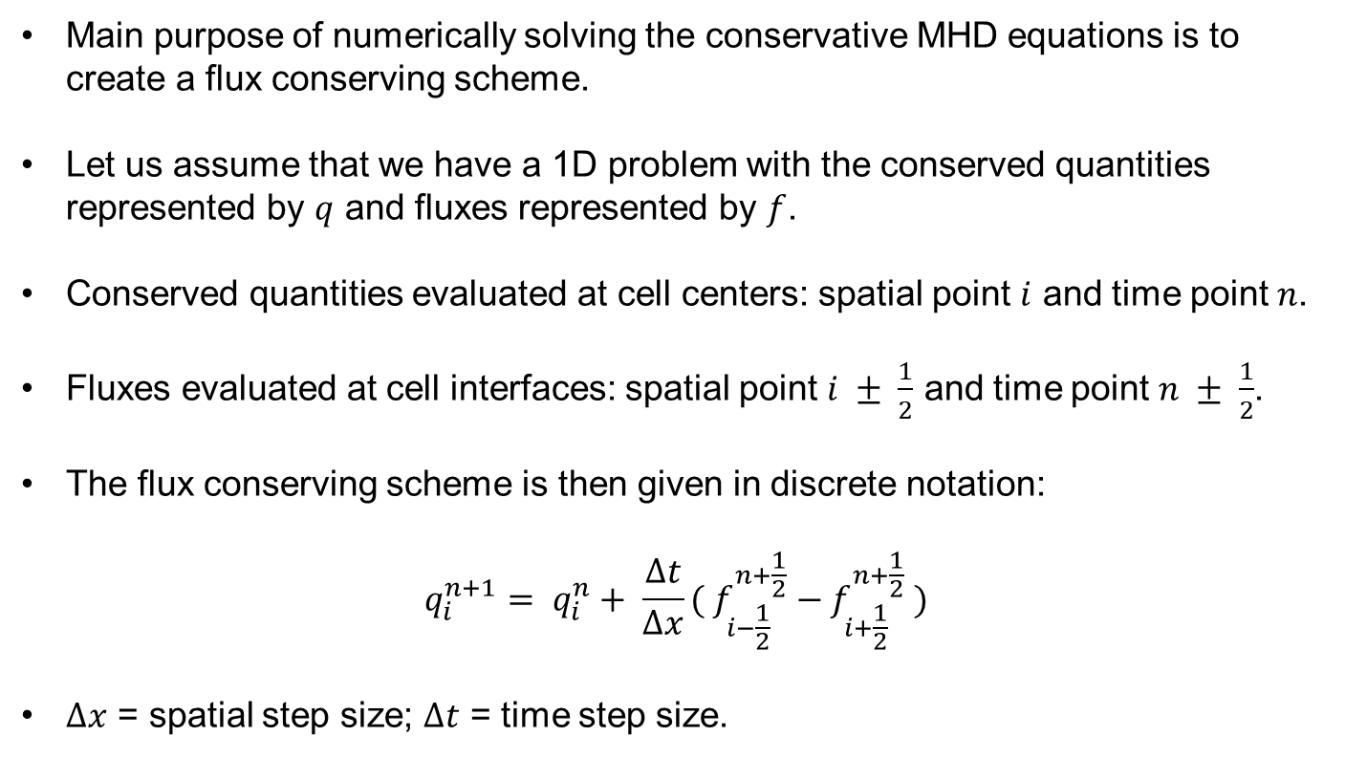
Numerically Solving Conservative MHD Equations
Main purpose of numerically solving the conservative MHD equations is to create a flux conserving scheme.
Let us assume that we have a 1D problem with the conserved quantities represented by $q$ and fluxes represented by $f$.
Conserved quantities evaluated at cell centers: spatial point $i$ and time point $n$.
Fluxes evaluated at cell interfaces: spatial point $i ± \frac{1}{2}$ and time point $n ± \frac{1}{2}$.
The flux conserving scheme is then given in discrete notation:
$$q_{i}^{n+1}= q_{i}^{n}+ \frac{∆t}{∆x}({ f}_{i−\frac{1}{2}}^{n+\frac{1}{2}} − f_{i+\frac{1}{2}}^{n+\frac{1}{2}} )$$
$∆x$ = spatial step size; $∆t$ = time step size.

Slide 15
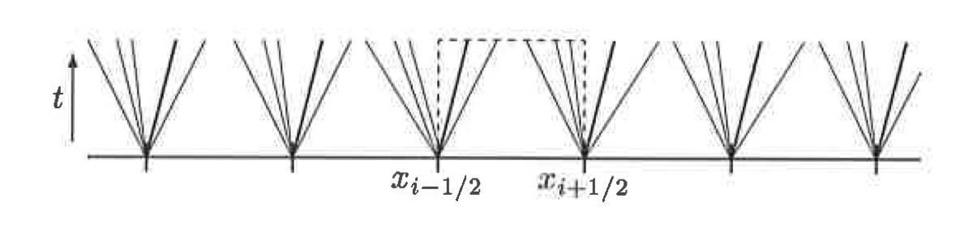
Godunov Method
Layout of Godunov Method
At each cell interface, it is assumed that the plasma encounters a shock surface.
Shock waves travel along the characteristic surfaces defined by the eigenvalues of the conservative MHD equations.
Jump conditions are then used to solve for the spatial variation of the plasma motion across each interface.
The full collection (unity) of the plasma motion across each interface is then used as the solution of the spatial variation of the MHD equations for a single time step.

Slide 16
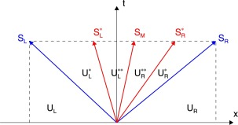
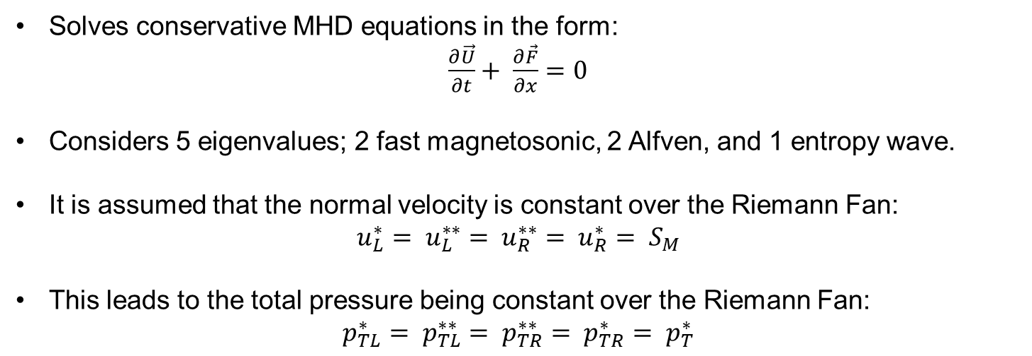
Flux Solver: HLLD Scheme
Layout of HLLD Flux Solver
Solves conservative MHD equations in the form:
$\frac{∂\vec{U}}{∂t}+ \frac{∂\vec{F}}{∂x}=0$
Considers 5 eigenvalues; 2 fast magnetosonic, 2 Alfven, and 1 entropy wave.
It is assumed that the normal velocity is constant over the Riemann Fan:
$$u_{L}^{∗}= u_{L}^{∗∗}= u_{R}^{∗∗}= u_{R}^{∗}= S_{M}$$
This leads to the total pressure being constant over the Riemann Fan:
$$p_{TL}^{∗}= p_{TL}^{∗∗}= p_{TR}^{∗∗}= p_{TR}^{∗}= p_{T}^{∗}$$

Slide 17
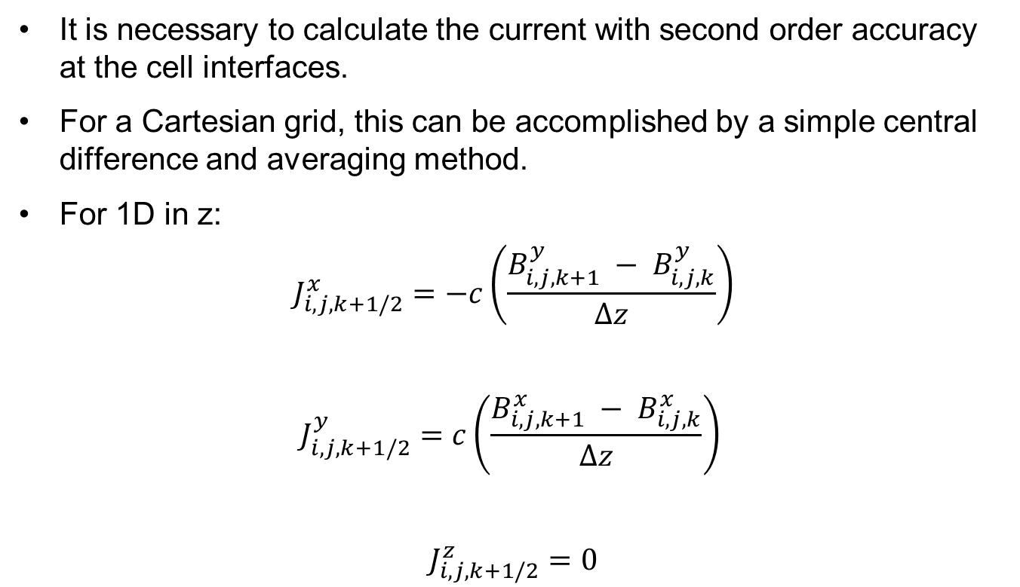
Resistive MHD
It is necessary to calculate the current with second order accuracy at the cell interfaces.
For a Cartesian grid, this can be accomplished by a simple central difference and averaging method.
For 1D in z:
$$J_{i,j,k+1/2}^{x}=−c\left(\frac{B_{i,j,k+1}^{y} − B_{i,j,k}^{y}}{∆z}\right)$$
$$J_{i,j,k+1/2}^{y}=c\left(\frac{B_{i,j,k+1}^{x} − B_{i,j,k}^{x}}{∆z}\right)$$
$$J_{i,j,k+1/2}^{z}=0$$

Slide 18
Steady State Results

Slide 19
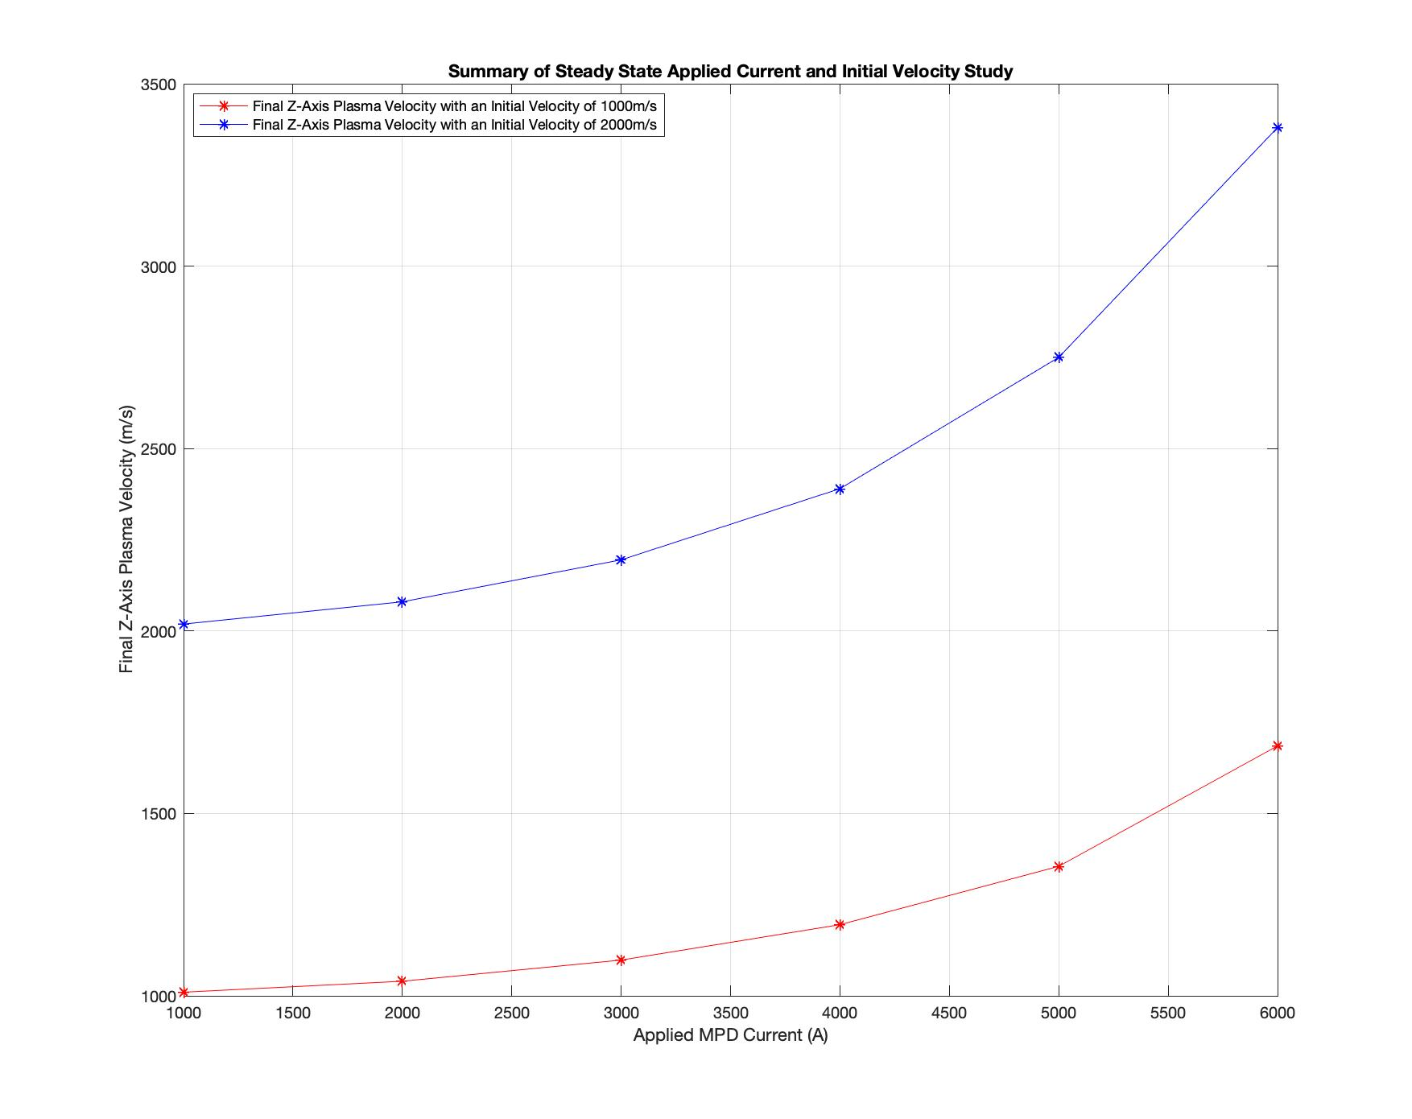
Steady-State MHD Results Initial Velocity
Current has a positive effect on the plasma acceleration.
Initial velocity of 1000m/s only results in a minimal plasma acceleration, where an initial velocity of 2000m/s results in a sizeable acceleration.
Plasma does not receive a significant acceleration until a current of at least 3000A is applied to the MPD.
MPD must have a large applied current in order to operate as an effective thruster or plasma accelerator.

Slide 20
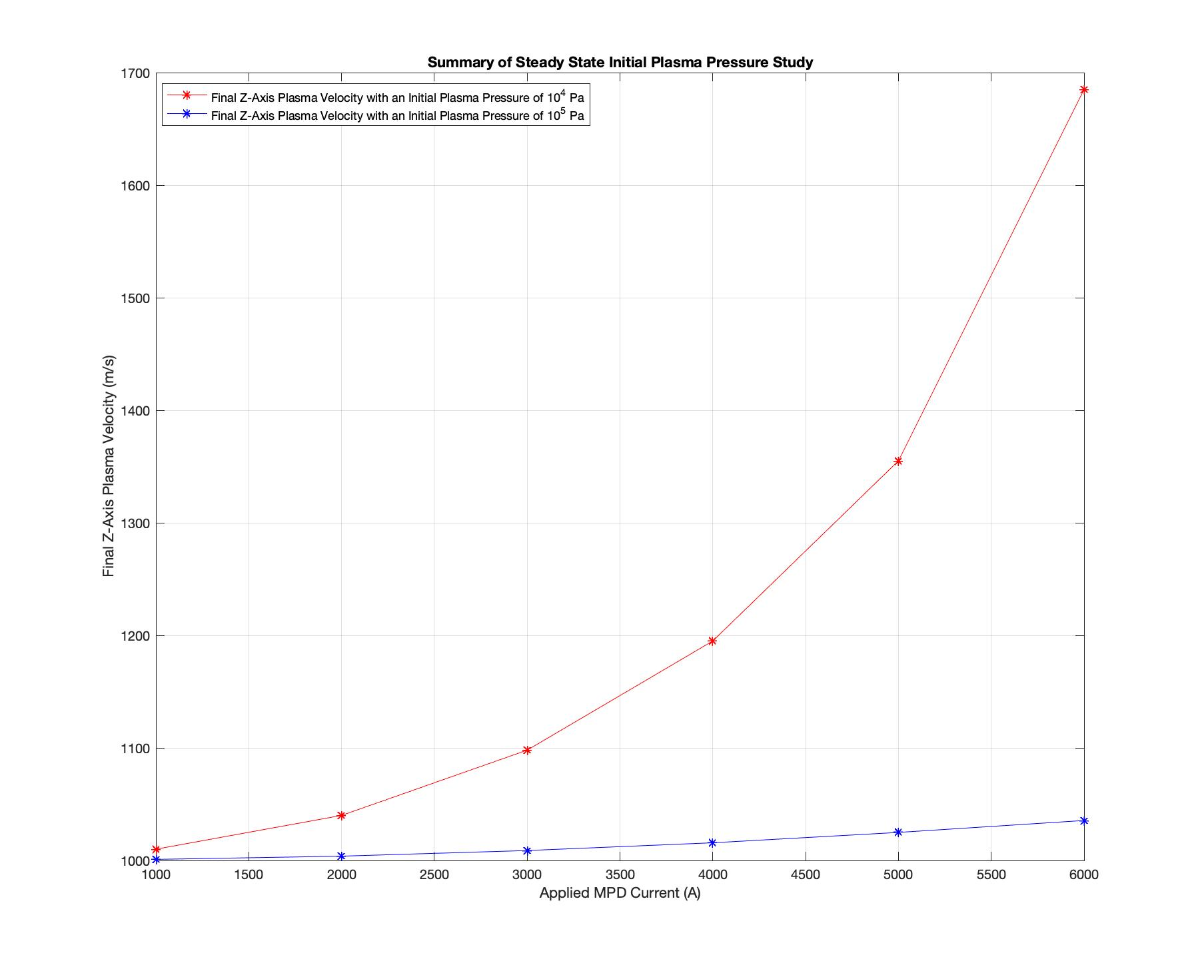
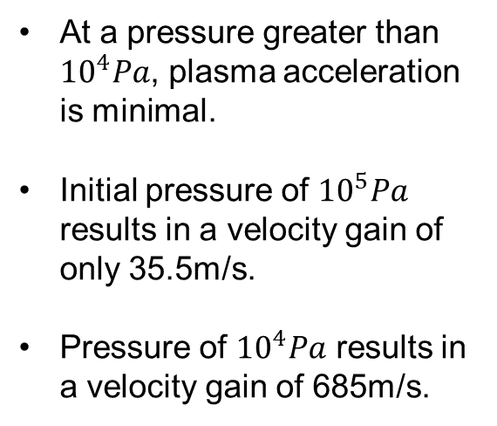
Steady-State MHD Results Plasma Pressure
At a pressure greater than ${10}^{4}Pa$, plasma acceleration is minimal.
Initial pressure of ${10}^{5}Pa$ results in a velocity gain of only 35.5m/s.
Pressure of ${10}^{4}Pa$ results in a velocity gain of 685m/s.

Slide 21
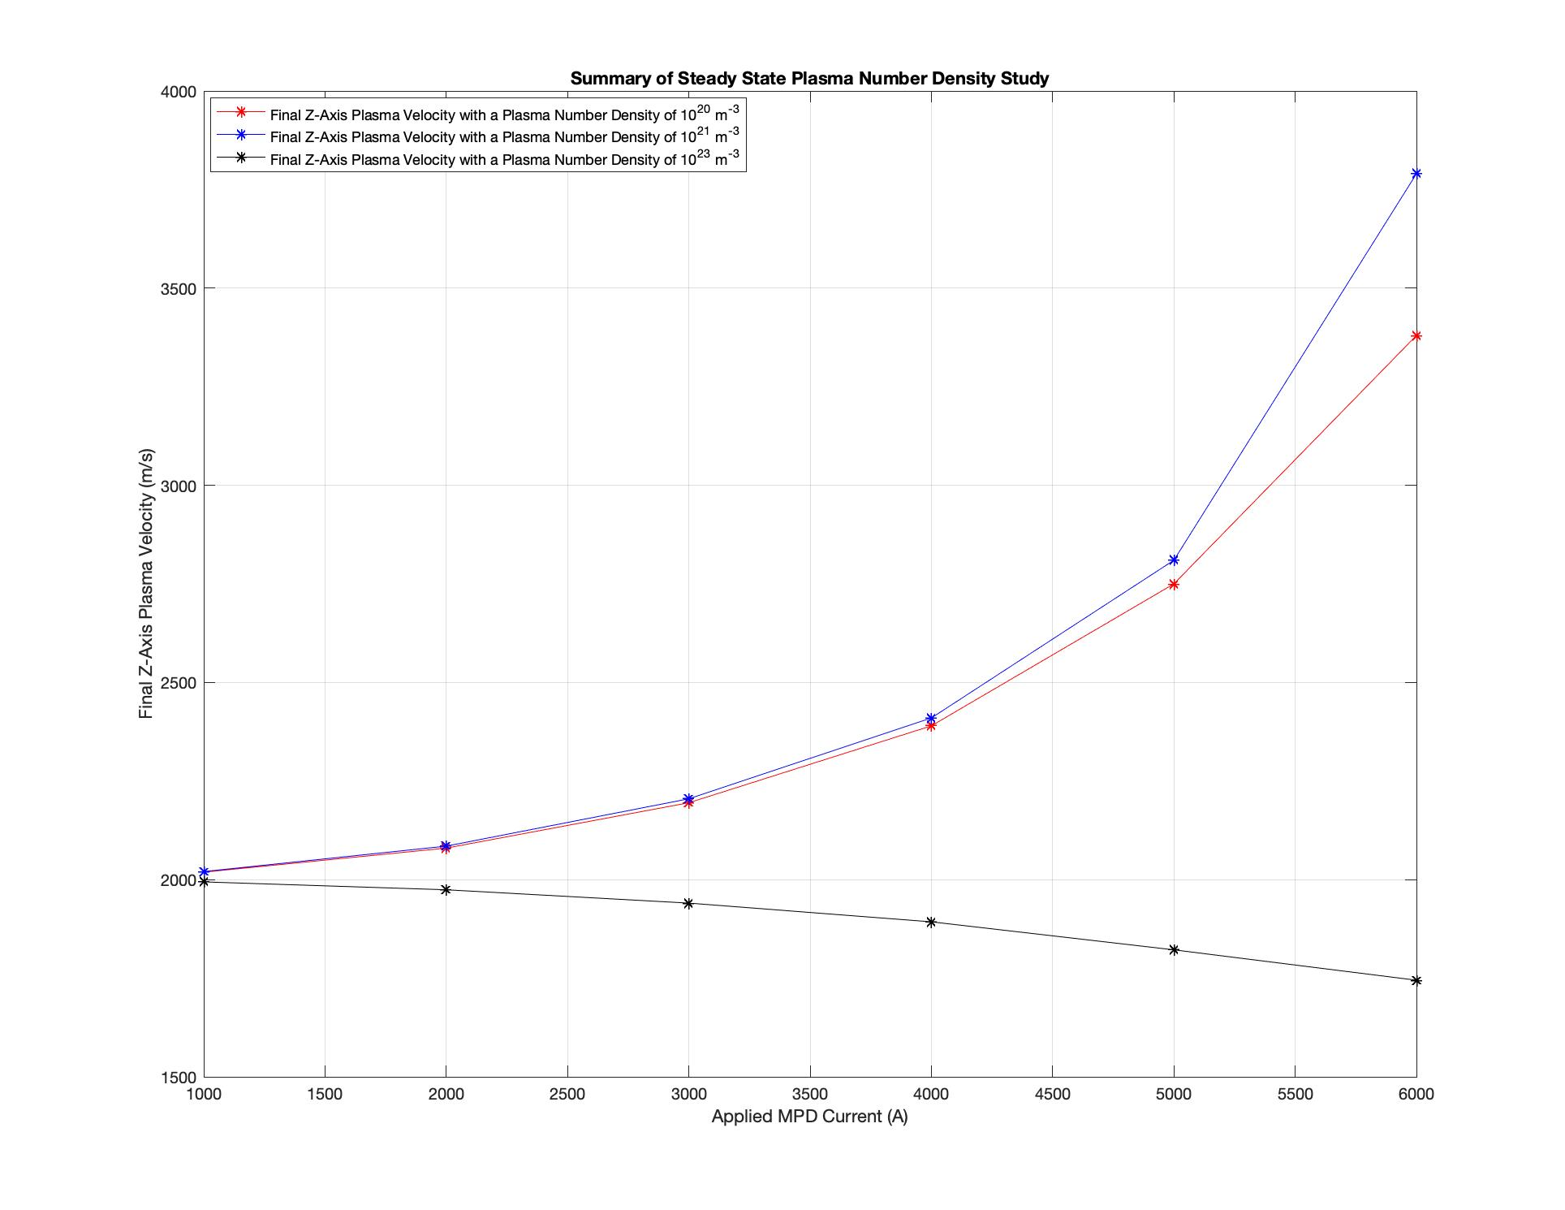
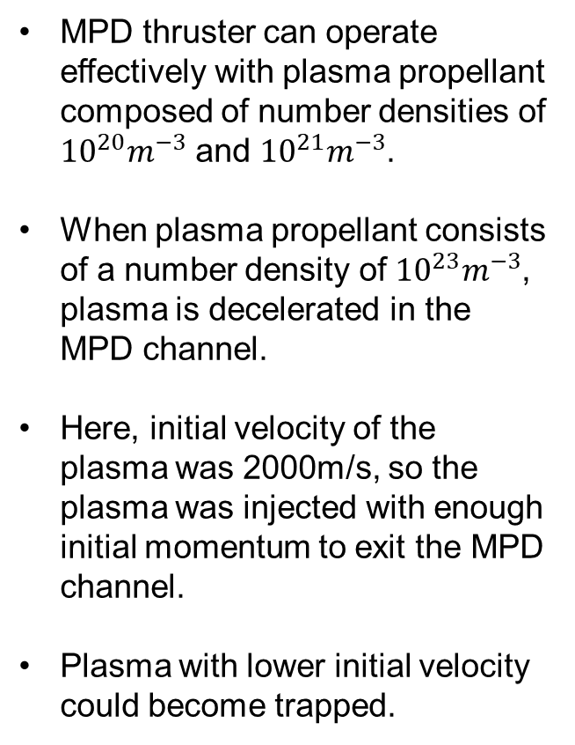
Steady-State MHD Results Density
MPD thruster can operate effectively with plasma propellant composed of number densities of ${10}^{20}m^{−3}$ and ${10}^{21}m^{−3}$.
When plasma propellant consists of a number density of ${10}^{23}m^{−3}$, plasma is decelerated in the MPD channel.
Here, initial velocity of the plasma was 2000m/s, so the plasma was injected with enough initial momentum to exit the MPD channel.
Plasma with lower initial velocity could become trapped.

Slide 22
Limitations of Steady-State Model
Model considers a 1D flow of plasma, requiring that the plasma can only flow in the z direction.
There are many interactions along the x and y directions which are ignored in this model.
Many time-dependent interactions that are assumed to have been removed from the plasma over time.
Does not model the effects that would be seen in a heavy ion plasma driver.

Slide 23
Time-Dependent Results

Slide 24
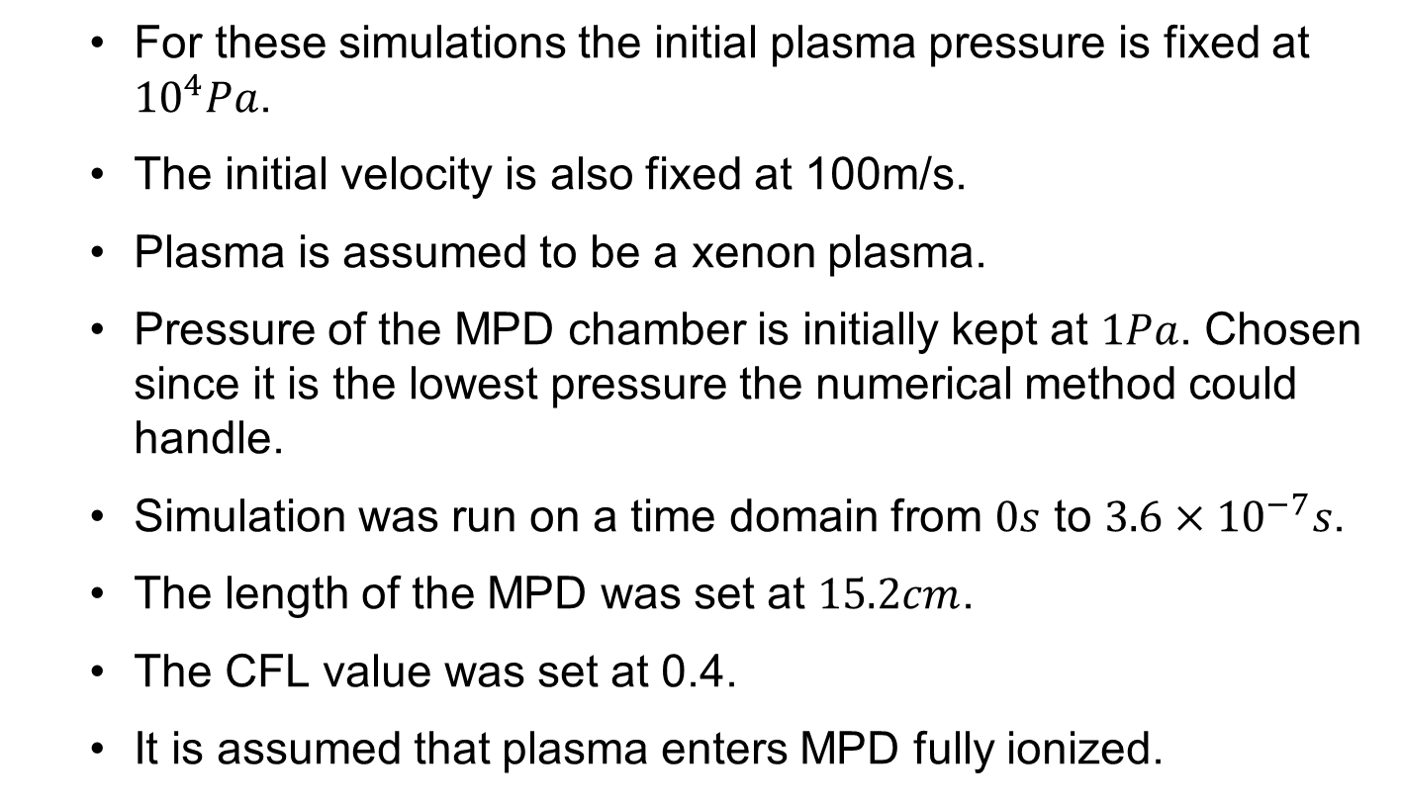
Time-Dependent Results
For these simulations the initial plasma pressure is fixed at ${10}^{4}Pa$.
The initial velocity is also fixed at 100m/s.
Plasma is assumed to be a xenon plasma.
Pressure of the MPD chamber is initially kept at $1Pa$. Chosen since it is the lowest pressure the numerical method could handle.
Simulation was run on a time domain from $0s$ to $3.6×{10}^{−7}s$.
The length of the MPD was set at $15.2cm$.
The CFL value was set at 0.4.
It is assumed that plasma enters MPD fully ionized.

Slide 25
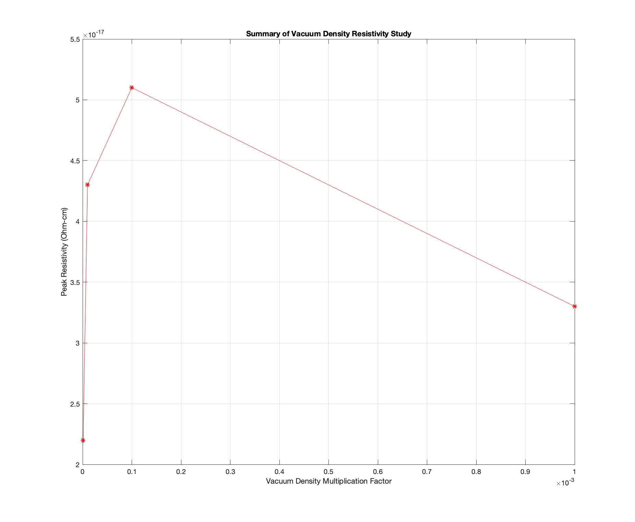
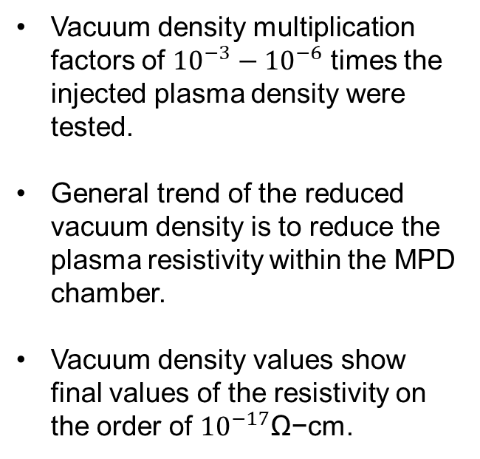
Time-Dependent Results
Vacuum Density Studies: Resistivity
Vacuum density multiplication factors of ${10}^{−3}−{10}^{−6}$ times the injected plasma density were tested.
General trend of the reduced vacuum density is to reduce the plasma resistivity within the MPD chamber.
Vacuum density values show final values of the resistivity on the order of ${10}^{−17}$Ω−cm.

Slide 26
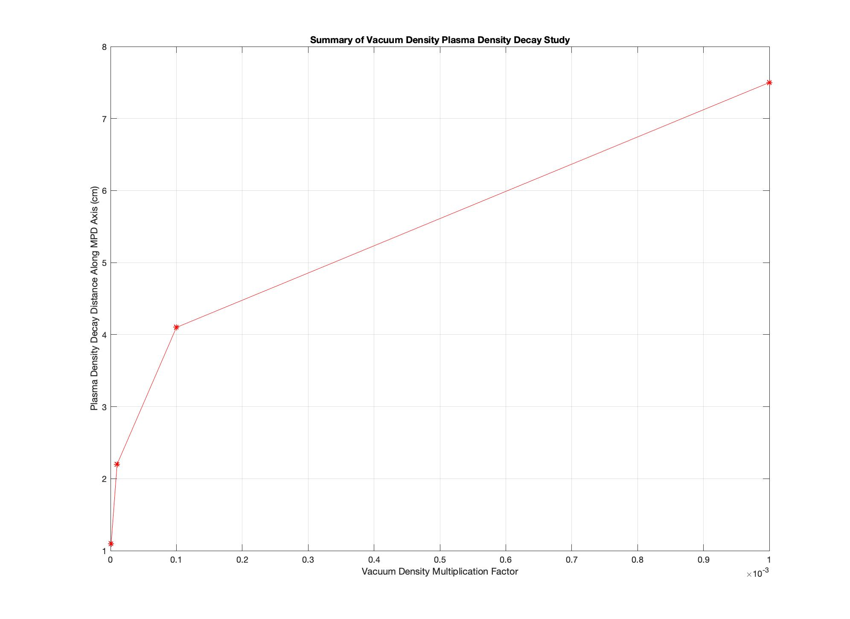
Time-Dependent Results
Vacuum Density Studies: Plasma Expansion
The lower the vacuum plasma density, the shorter the plasma density decay distance.
Trade off for the decrease in vacuum plasma density is the increase in plasma expansion.
Plasma beams for heavy ion drivers must remain compact in order to effectively function as a spherical liner for target implosion.
Plasma accelerated within an MPD thruster may expand too rapidly within the chamber to be used in a heavy ion driver.

Slide 27
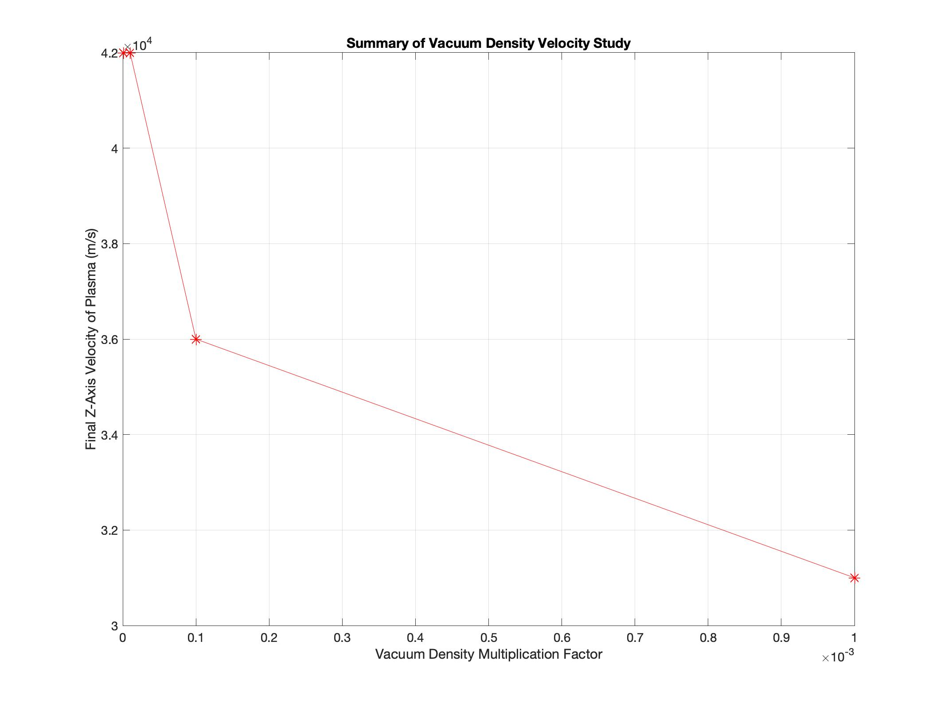
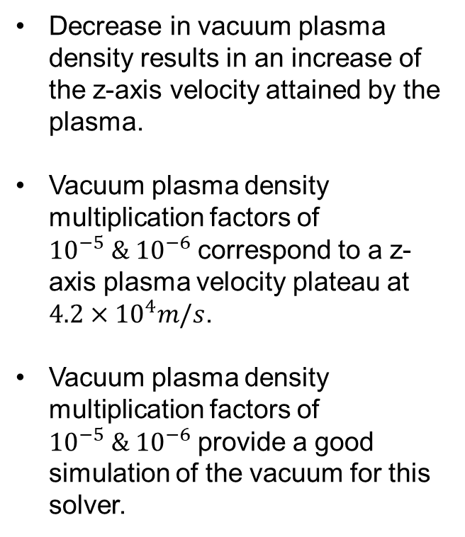
Time-Dependent Results
Vacuum Density Studies: Axial Velocity
Decrease in vacuum plasma density results in an increase of the z-axis velocity attained by the plasma.
Vacuum plasma density multiplication factors of ${10}^{−5} \& {10}^{−6}$ correspond to a z-axis plasma velocity plateau at $4.2×{10}^{4}m/s$.
Vacuum plasma density multiplication factors of ${10}^{−5} \& {10}^{−6}$ provide a good simulation of the vacuum for this solver.

Slide 28
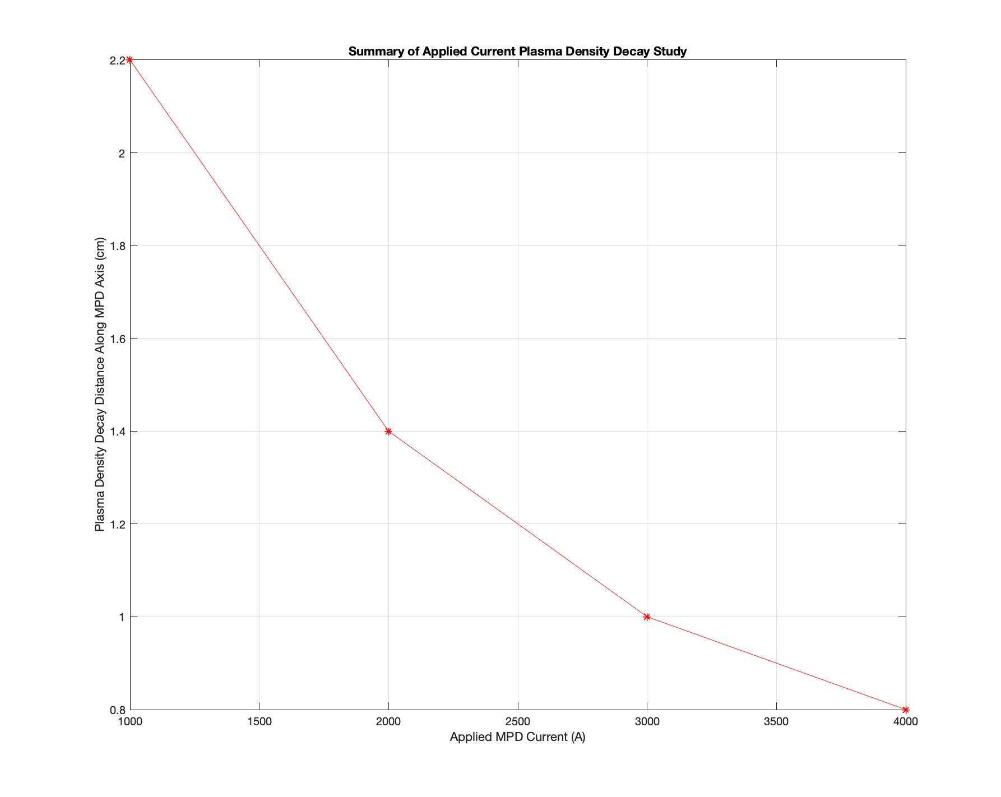
Time-Dependent Results
Applied Current Studies: Plasma Expansion
The greater the current applied to the MPD thruster, the shorter the plasma density decay distance.
1000A current corresponds to a decay distance of 2.2cm, where as 4000A corresponds to a decay distance of 0.8cm.
Therefore, low-power MPD thrusters are more desirable for heavy ion drivers in terms of plasma expansion within the MPD channel.

Slide 29
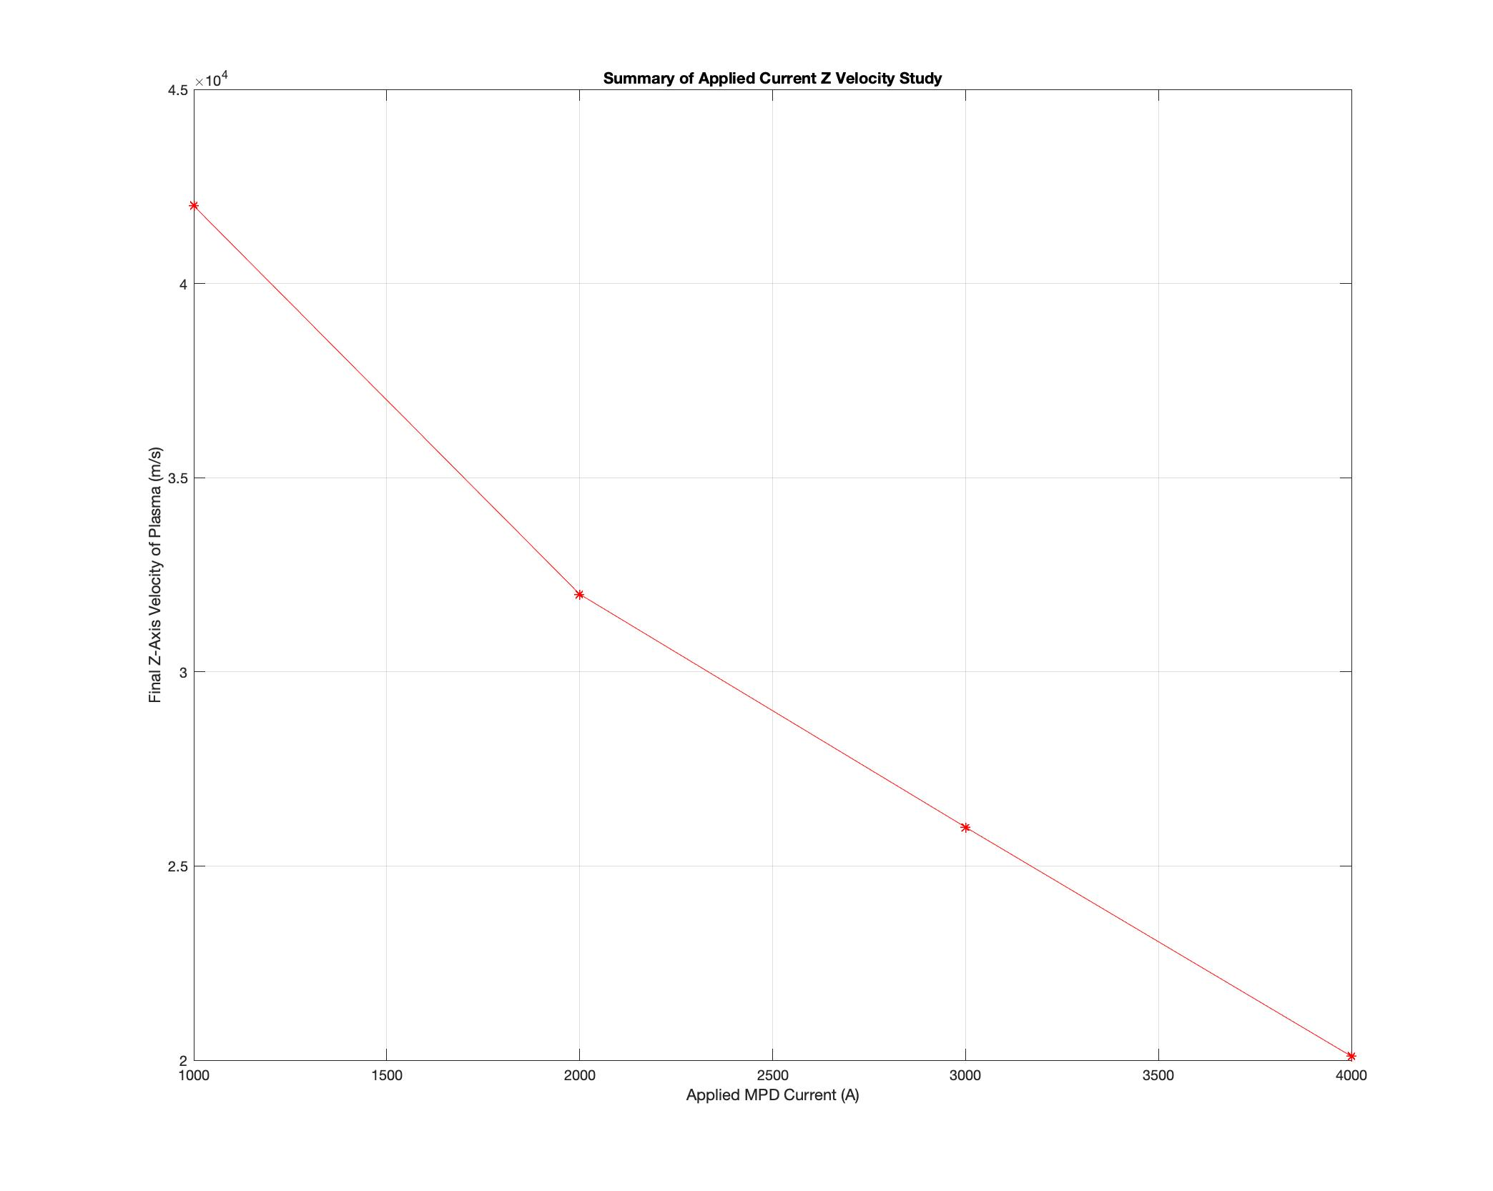
Time-Dependent Results
Applied Current Studies: Axial Velocity
The higher the applied MPD current, the lower the z-axis plasma velocity at the thruster outlet.
Since the plasma is initially maintained at a high pressure, the primary mechanism of the plasma’s initial acceleration is not electromagnetic, but hydrodynamic.
Higher applied currents then accelerate the plasma out of the thruster before the plasma column can feel the full effects of the force from the hydrodynamic expansion.

Slide 30
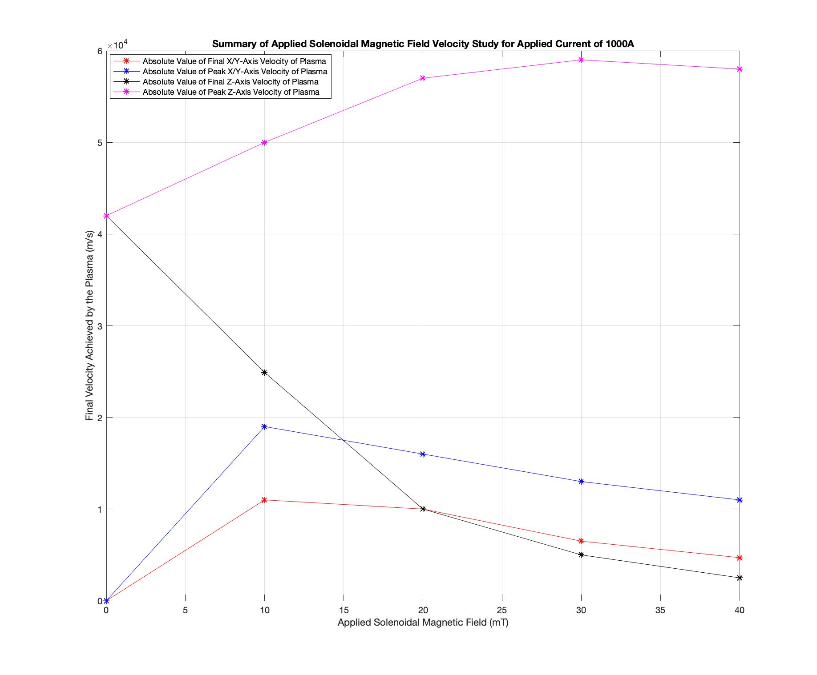
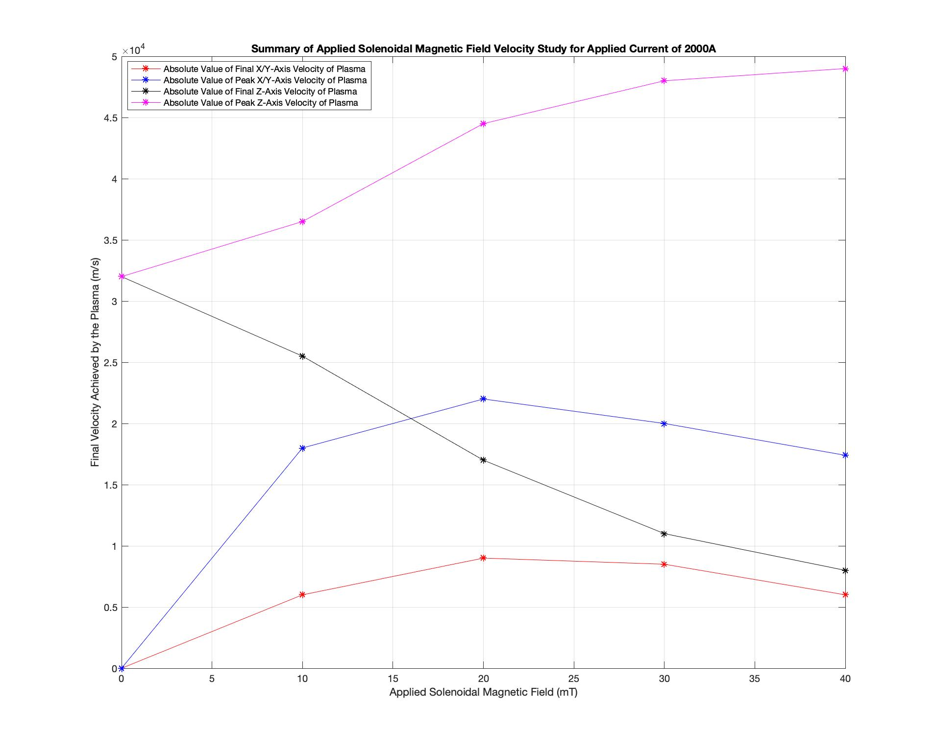
Time-Dependent Results
Applied Magnetic Field Studies: Axial and Azimuthal Velocity

Slide 31
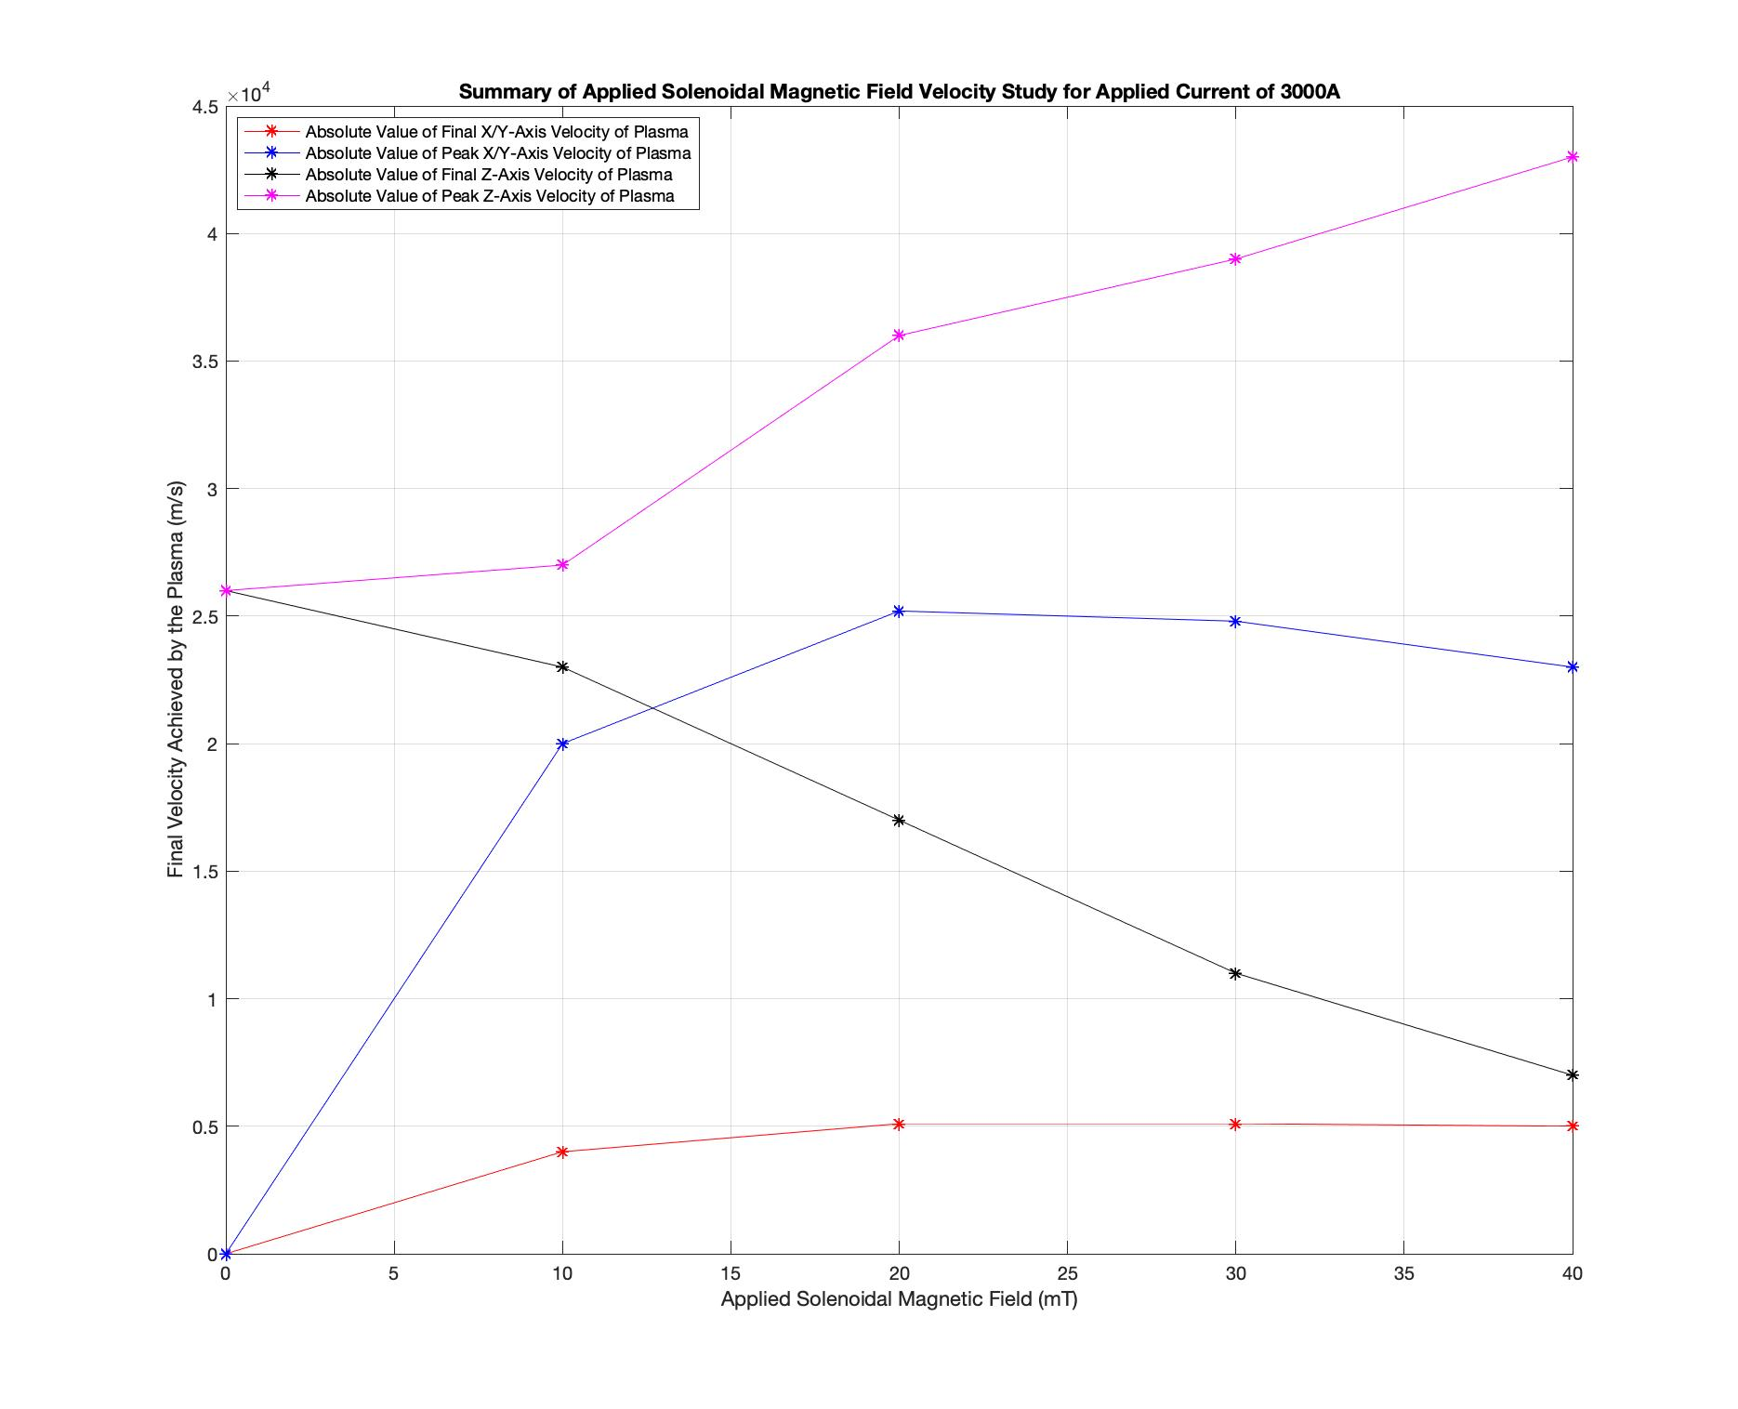
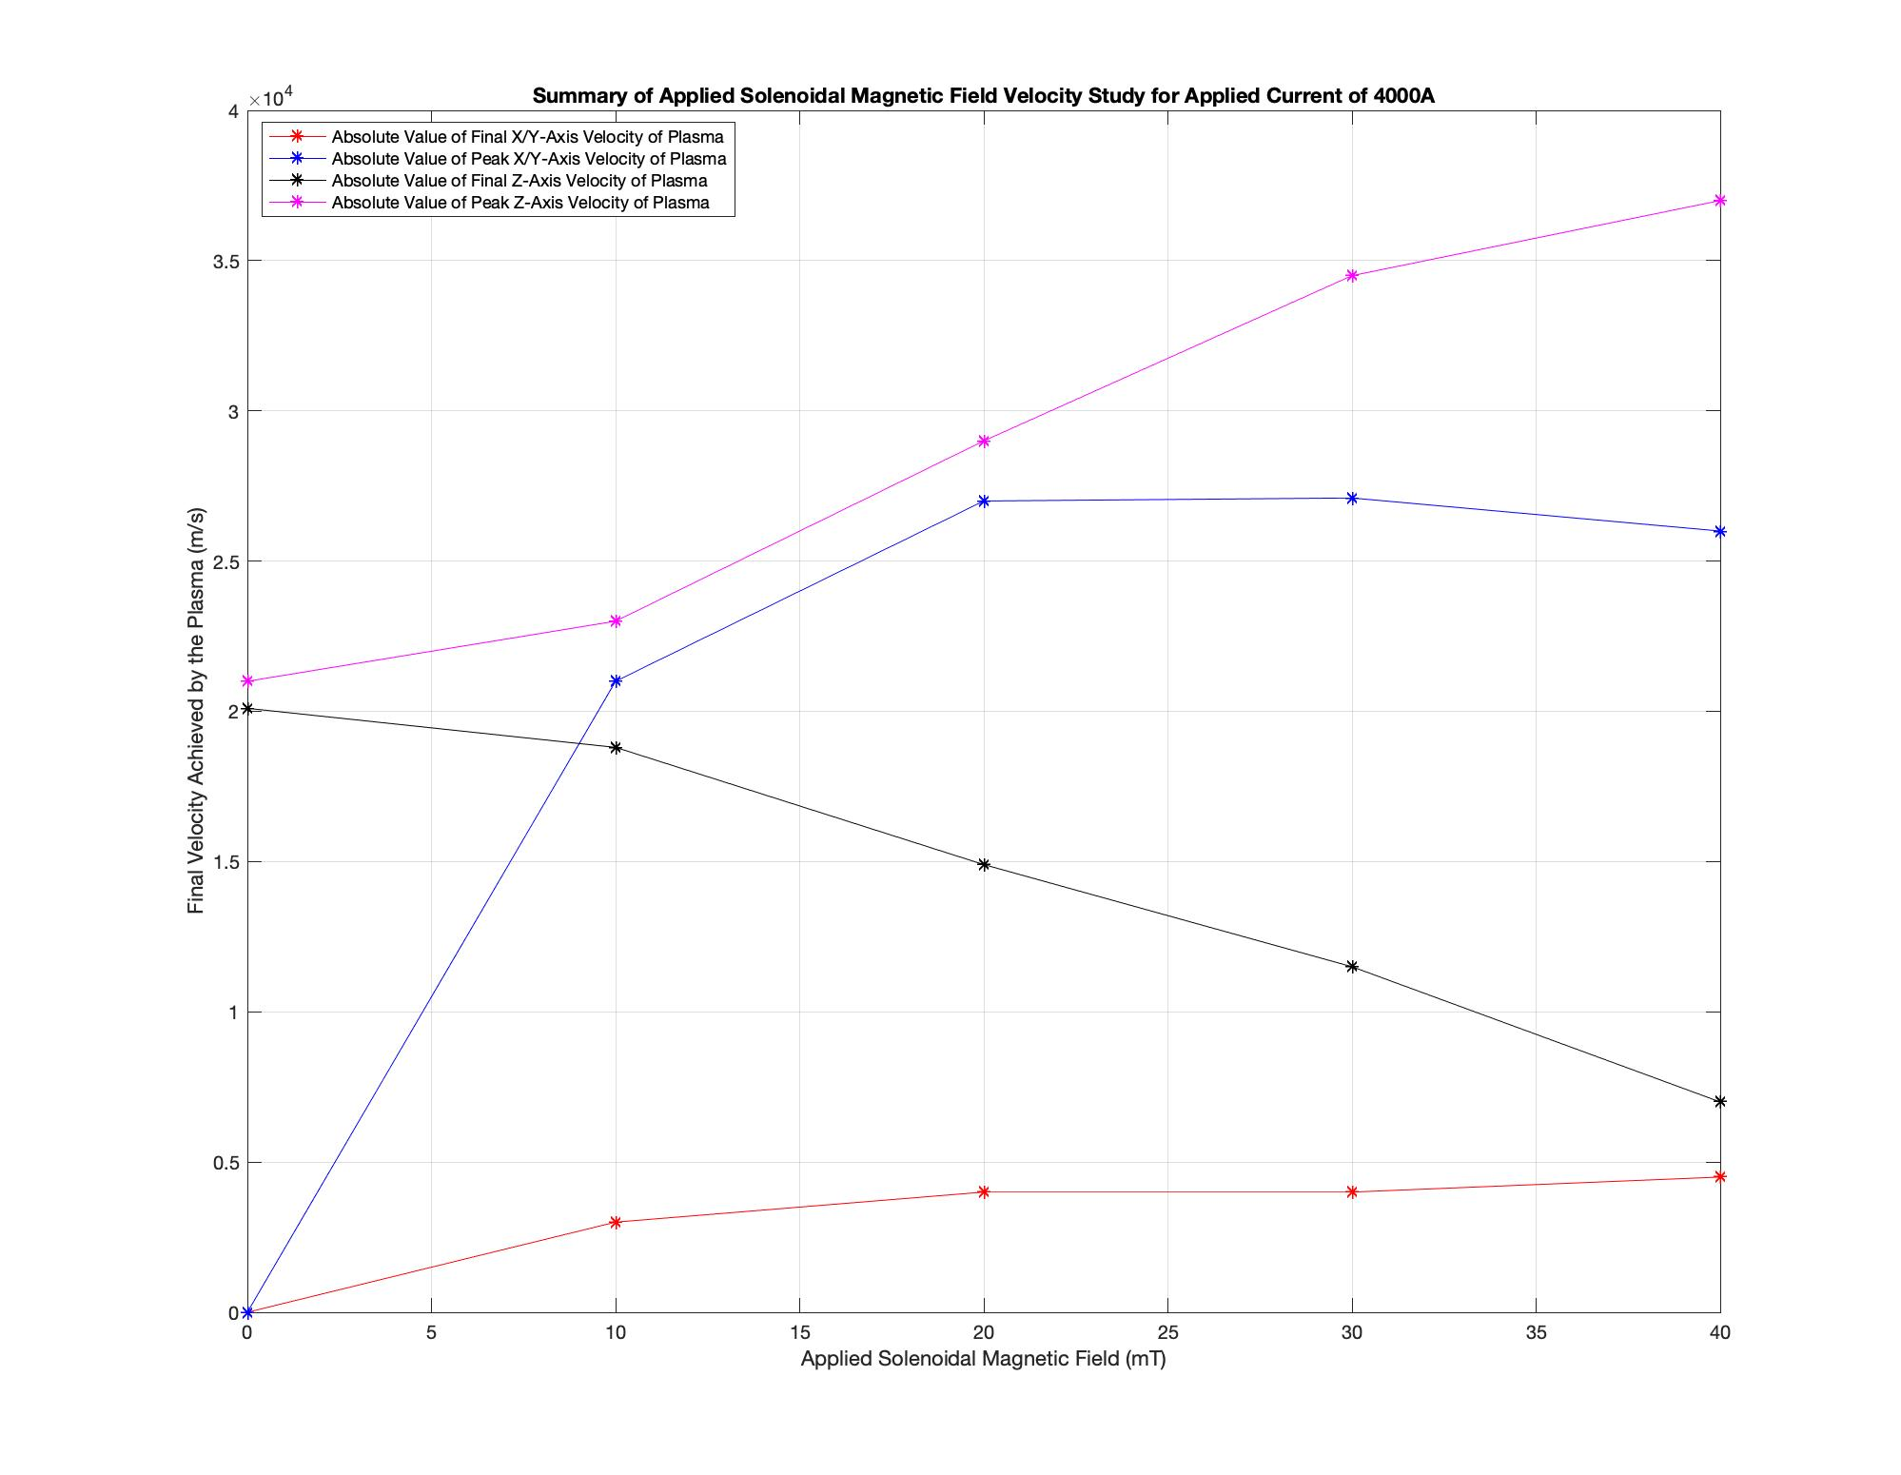
Time-Dependent Results
Applied Magnetic Field Studies: Axial and Azimuthal Velocity

Slide 32
Time-Dependent Results
Applied Magnetic Field Studies
Final z-axis plasma velocity decrease is positively correlated with the increase in the final x/y-axis velocity attained by the plasma.
The swirling motion is generated within the plasma by energy from the axial motion of the plasma being transferred to the azimuthal motion of the plasma, therefore a positive correlation is expected.
Peak z-axis velocity attained by the plasma within the MPD thruster increases with applied magnetic field.
Peak z-axis velocity is obtained near the inlet of the MPD thruster, implying that the applied magnetic field induces an additional axial force at the thruster inlet.
Peak x/y-axis velocity obtained by the plasma increases as well.
The x/y-axis peak velocity is maximized by the application of a solenoidal magnetic field in the range of 20mT−30mT.

Slide 33
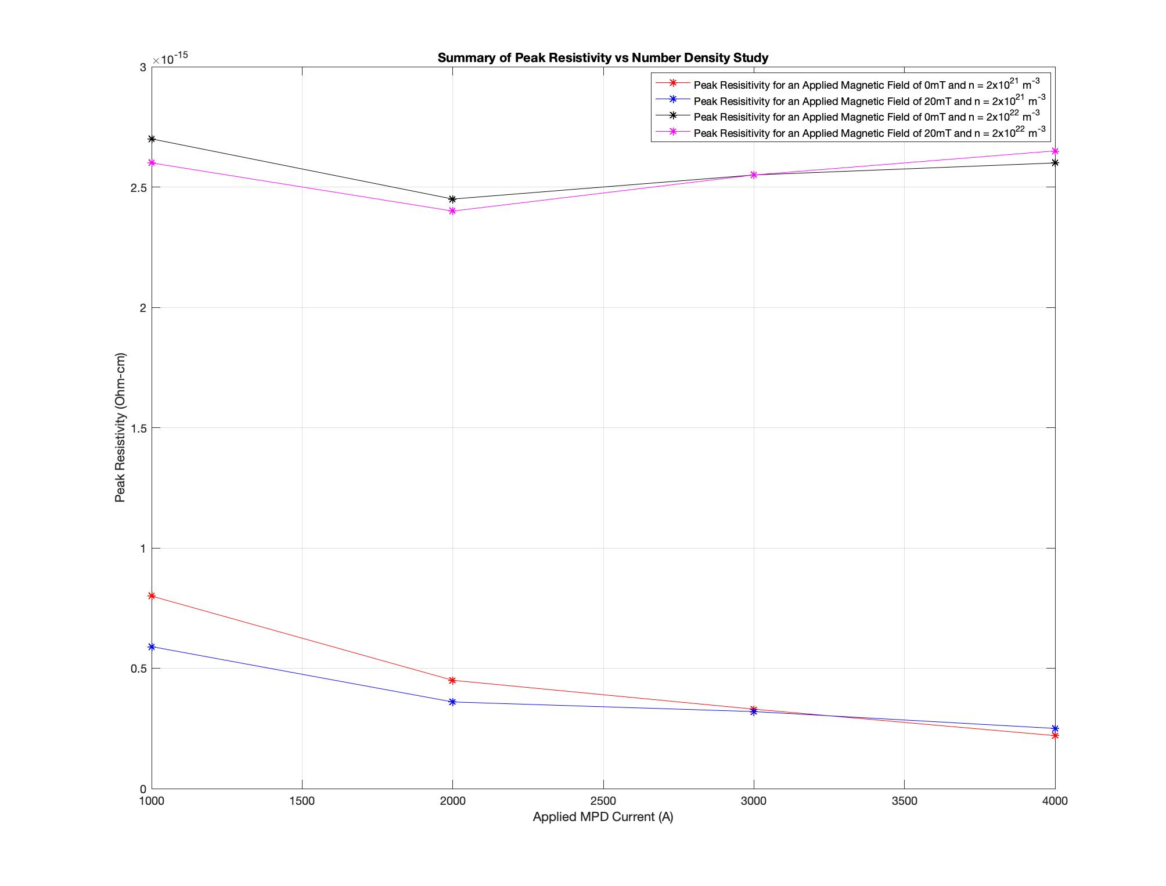
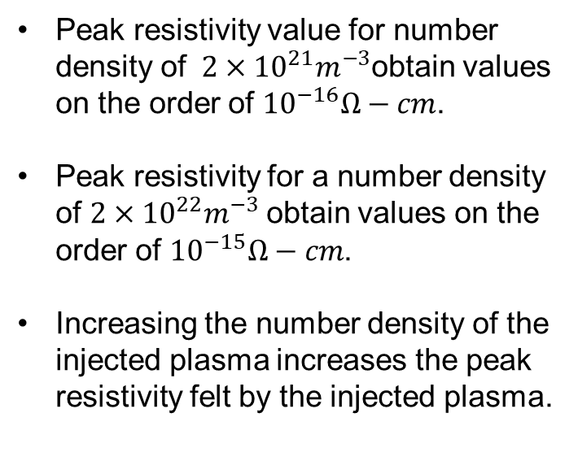
Time-Dependent Results
Number Density Study: Resistivity
Peak resistivity value for number density of $2×{10}^{21}m^{−3}$obtain values on the order of ${10}^{−16}Ω−cm$.
Peak resistivity for a number density of $2×{10}^{22}m^{−3}$obtain values on the order of ${10}^{−15}Ω−cm$.
Increasing the number density of the injected plasma increases the peak resistivity felt by the injected plasma.

Slide 34
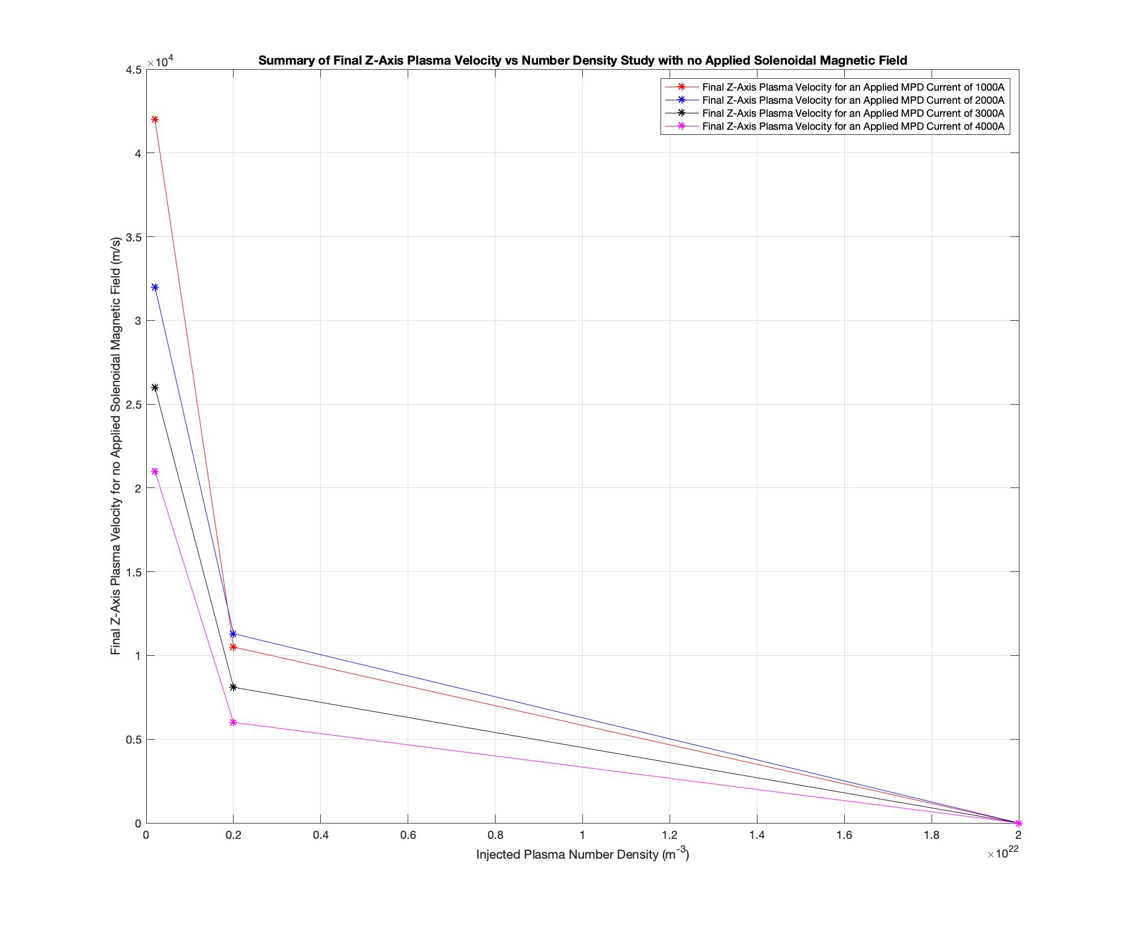
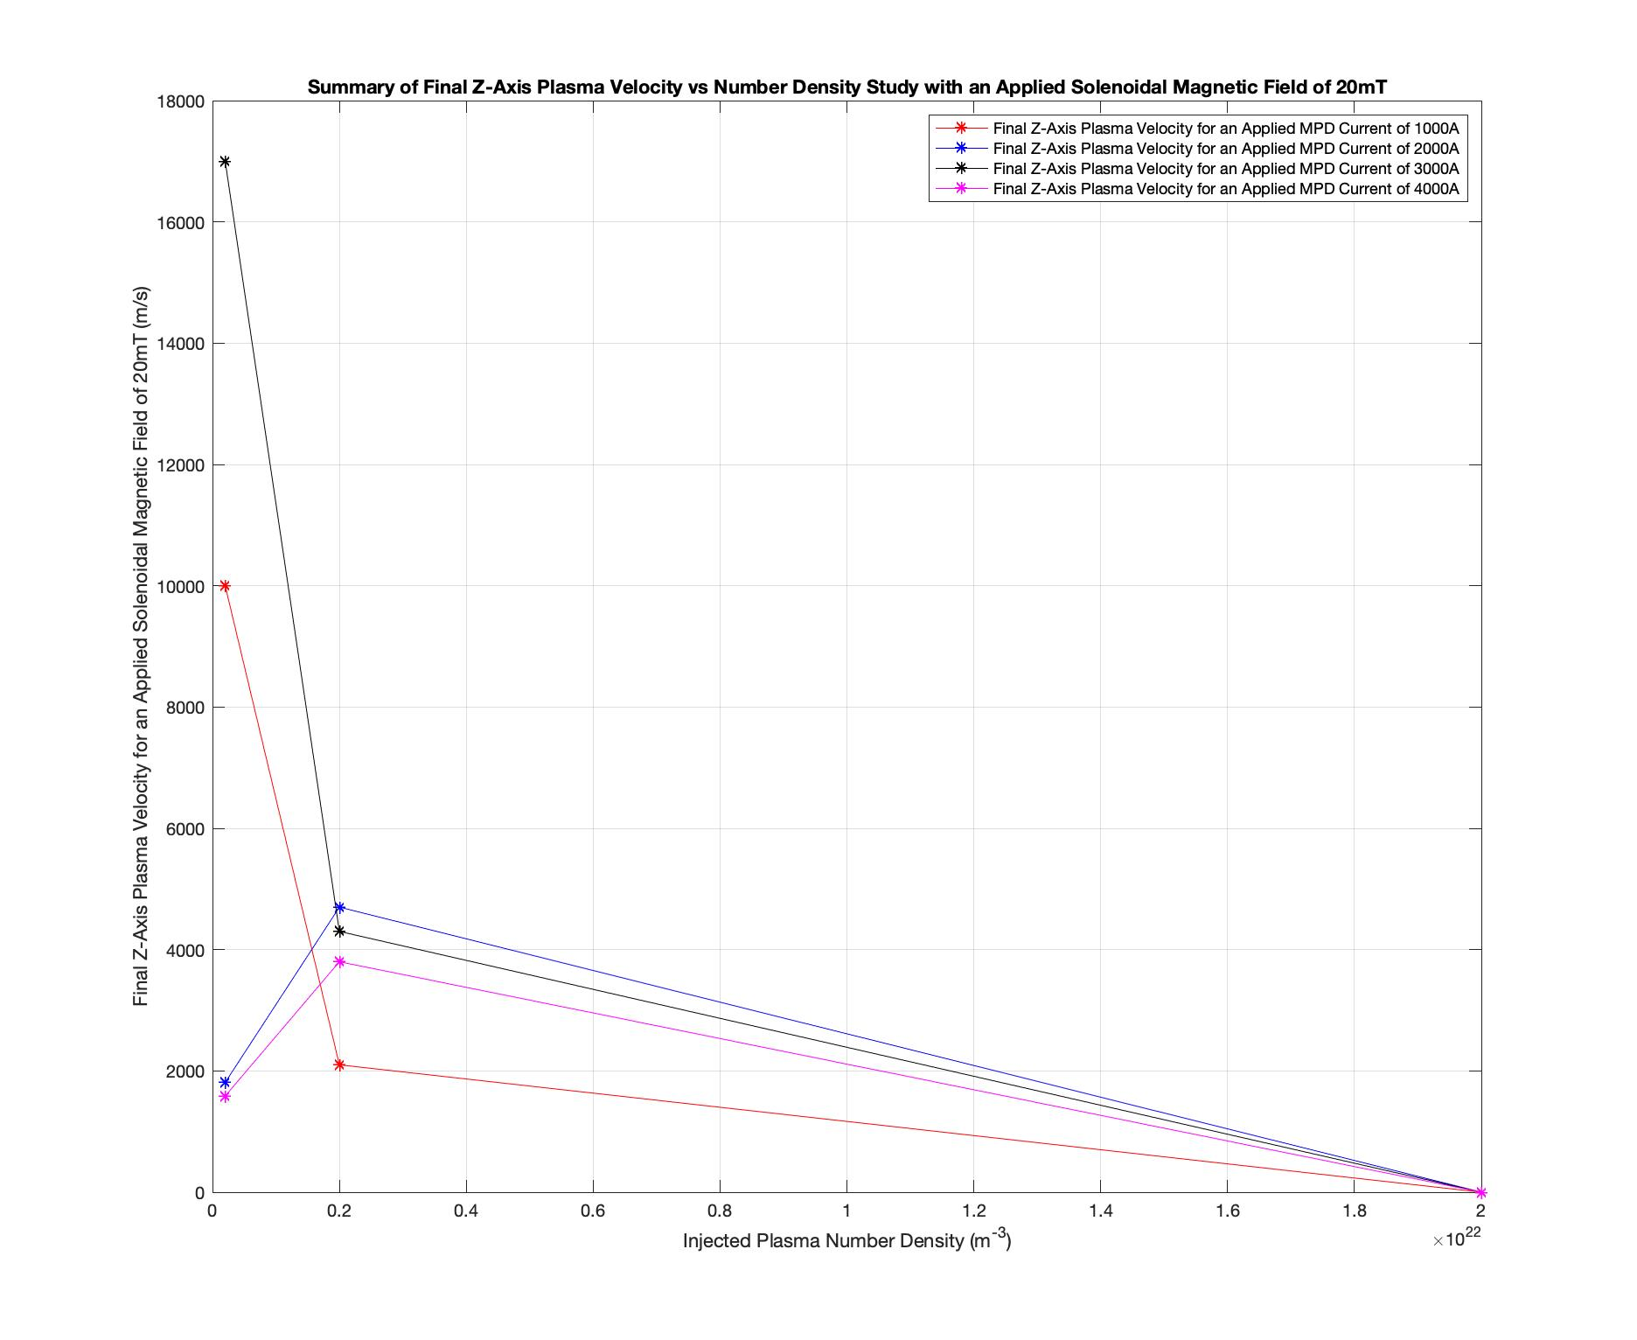
Time-Dependent Results
Number Density Study: Axial Velocity

Slide 35
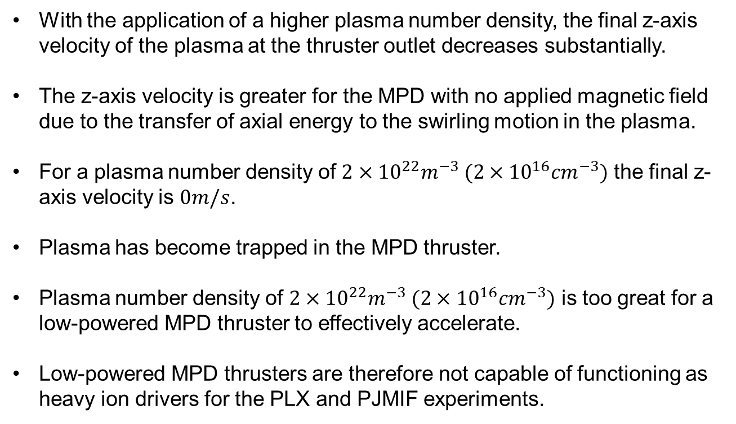
Time-Dependent Results
Number Density Study: Axial Velocity
With the application of a higher plasma number density, the final z-axis velocity of the plasma at the thruster outlet decreases substantially.
The z-axis velocity is greater for the MPD with no applied magnetic field due to the transfer of axial energy to the swirling motion in the plasma.
For a plasma number density of $2×{10}^{22}m^{−3} (2×{10}^{16}{cm}^{−3})$ the final z-axis velocity is $0m/s$.
Plasma has become trapped in the MPD thruster.
Plasma number density of $2×{10}^{22}m^{−3} (2×{10}^{16}{cm}^{−3})$ is too great for a low-powered MPD thruster to effectively accelerate.
Low-powered MPD thrusters are therefore not capable of functioning as heavy ion drivers for the PLX and PJMIF experiments.

Slide 36
Limitations of this Model
This method cannot handle a true vacuum, there must be a plasma present everywhere in the solution domain.
Interactions between the plasma injected into the MPD chamber and the plasma used to model the vacuum density may be affecting the plasma motion.
This code uses the HLLD solver and does not consider the slow magnetosonic speeds in its solution of the Riemann problem.
It is assumed that the normal velocity and total pressure are constant across the Riemann fan.
Since the two initial regions of plasma are very different in regard to mass density, pressure, magnitude of the magnetic field, and initial velocity; there may be severe instabilities caused by the interactions of these two regions which significantly affect the solution.

Slide 37
Limitations of this Model
This model only considers a single fluid MHD model.
There are effects such as multi-fluid interactions that are necessary in the simulation of plasma drivers for PJMIF that are missed in this code base.
This model uses the ideal gas law as the equation of state.
Numerous effects from the interactions of the plasma particles with the current from the cathode to the anode and self interactions are missed.
The final velocities achieved in these simulations are an over-estimate of the plasma velocity as collisions and viscous drag effects are ignored.
It is also assumed that the plasma enters the MPD channel fully ionized, which is not true in most real world MPD thrusters.

Slide 38

Conclusions
In the steady state regime for initial velocities on the order of $1000m/s$, a plasma density of ${10}^{23}m^{−3}$ is the maximum critical operating density for low-powered MPD thrusters.
Time dependent simulations showed that for initial velocities on the order of 100m/s, a plasma density of $2×{10}^{22}m^{−3}$ is the maximum critical operating density for low powered MPD thrusters.
The swirling motion caused by an applied solenoidal magnetic field was observed and found to be dependent on the strength of the applied magnetic field.
The application of the solenoidal magnetic field increased the initial axial acceleration of the plasma column.
The velocities achieved by the plasma column were very high, on the order of $42km/s$ for a current of $1000A$ and no applied magnetic field.

Slide 39
Conclusions
The conclusion of this research is:
MPD thrusters show promise as a plasma accelerator for heavy ions; but low powered MPD thrusters cannot be used for PJMIF drivers, even with high initial plasma pressure, due to the maximum operational number density being below the required plasma density for PJMIF studies.
Note: It is the conclusion of the author that these results should be taken with some suspicion since the accepted limitations give an over-estimate of the achieved plasma motion.

Slide 40
Future Work
The steady state models should be investigated in the full 3D regime.
The time dependent MPD thrusters should be investigated with higher order numerical methods; such as Particle in Cell (PIC) or full kinetic theory codes like Discontinuous Galerkin methods.
It is also imperative that these higher order codes be used to investigate the target compression, in order to better design the drivers to fit the full physics present in the target compression.

Slide 41
Questions

Slide 42
Back Up Slides

Slide 43
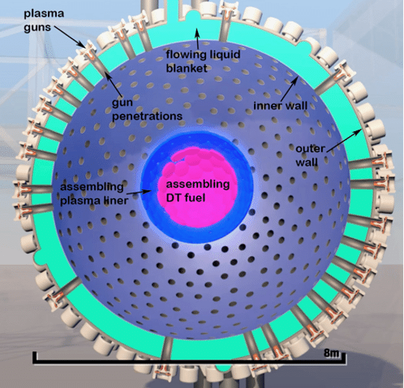
PJMIF Process
PJMIF Fusion Process:
Establish a magnetized target of fusion fuel at the center of the device (usually consisting of an ionized D-T plasma).
Energetic pulses of heavy ion plasma are propelled toward the magnetized target from a series of heavy ion drivers placed on the outer surface of the reactor.
Heavy ion plasma pulses form a spherical liner at the edge of the target surface.
Liner then forms a spherical compression surface which moves inward at a high velocity and compresses the magnetized target to fusion conditions.
PJMIF Reactor Concept

Slide 44
Plasma Drivers Overview
The three main types of plasma drivers currently under investigation:
Deflagration: A high voltage is applied between electrodes causing an arc to form in the plasma accelerating it forward by the Lorentz Force.
Snow-plow: A gun is pre-filled with ionized gas, electrons are accelerated by the Lorentz force dragging the electrons in the plasma by ambipolar diffusion. The dragged electrons then pull the ions in the plasma by the Lorentz Force.
Coaxial: A fast gas injection forms an initial gas slab which is pre-ionized, forming a compact, dense, and highly collisional plasma.

Slide 45
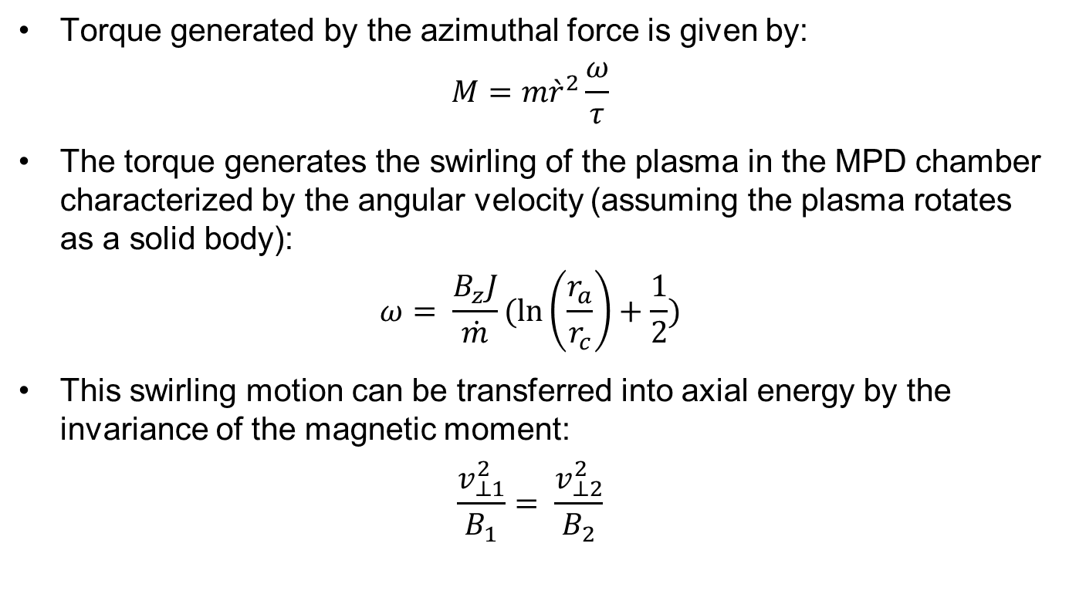
Swirling Motion
Torque generated by the azimuthal force is given by:
$$M=m{\grave{r}}^{2}\frac{ω}{τ}$$
The torque generates the swirling of the plasma in the MPD chamber characterized by the angular velocity (assuming the plasma rotates as a solid body):
$$ω= \frac{B_{z}J}{\dot{m}}(\ln\left(\frac{r_{a}}{r_{c}}\right)+\frac{1}{2})$$
This swirling motion can be transferred into axial energy by the invariance of the magnetic moment:
$$\frac{v_{⊥1}^{2}}{B_{1}}= \frac{v_{⊥2}^{2}}{B_{2}}$$

Slide 46
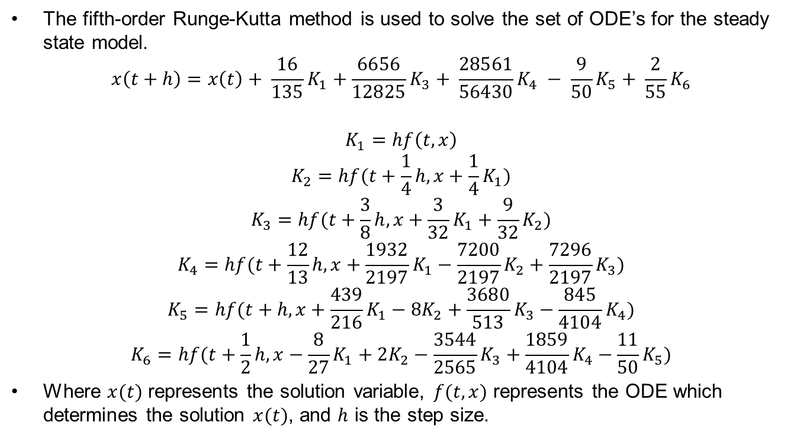
Steady-State MHD Numerical Method
The fifth-order Runge-Kutta method is used to solve the set of ODE’s for the steady state model.
$$x\left(t+h\right)=x\left(t\right)+ \frac{16}{135}K_{1}+\frac{6656}{12825}K_{3}+ \frac{28561}{56430}K_{4} − \frac{9}{50}K_{5}+ \frac{2}{55}K_{6}$$
$$K_{1}=hf\left(t,x\right)$$
$$K_{2}=hf(t+\frac{1}{4}h, x+\frac{1}{4}K_{1})$$
$$K_{3}=hf(t+\frac{3}{8}h, x+\frac{3}{32}K_{1}+\frac{9}{32}K_{2})$$
$$K_{4}=hf(t+\frac{12}{13}h, x+\frac{1932}{2197}K_{1}−\frac{7200}{2197}K_{2}+\frac{7296}{2197}K_{3})$$
$$K_{5}=hf(t+h, x+\frac{439}{216}K_{1}−8K_{2}+\frac{3680}{513}K_{3}−\frac{845}{4104}K_{4})$$
$$K_{6}=hf(t+\frac{1}{2}h, x−\frac{8}{27}K_{1}+2K_{2}−\frac{3544}{2565}K_{3}+\frac{1859}{4104}K_{4}−\frac{11}{50}K_{5})$$
Where $x(t)$ represents the solution variable, $f(t,x)$ represents the ODE which determines the solution $x(t)$, and $h$ is the step size.

Slide 47
MUSCL Schemes
Since each of the conserved variables is calculated at the cell centers, it is necessary to interpolate their values to the cell edges for calculation of the fluxes.
One method of accomplishing this is to assume a piecewise linear model.
Create a sub-grid model where each cell has its own linear or higher order interpolation from the cell center to the cell edges.
This is called a Monotonic Upwind-centered Scheme for Conservation Laws (MUSCL).

Slide 48
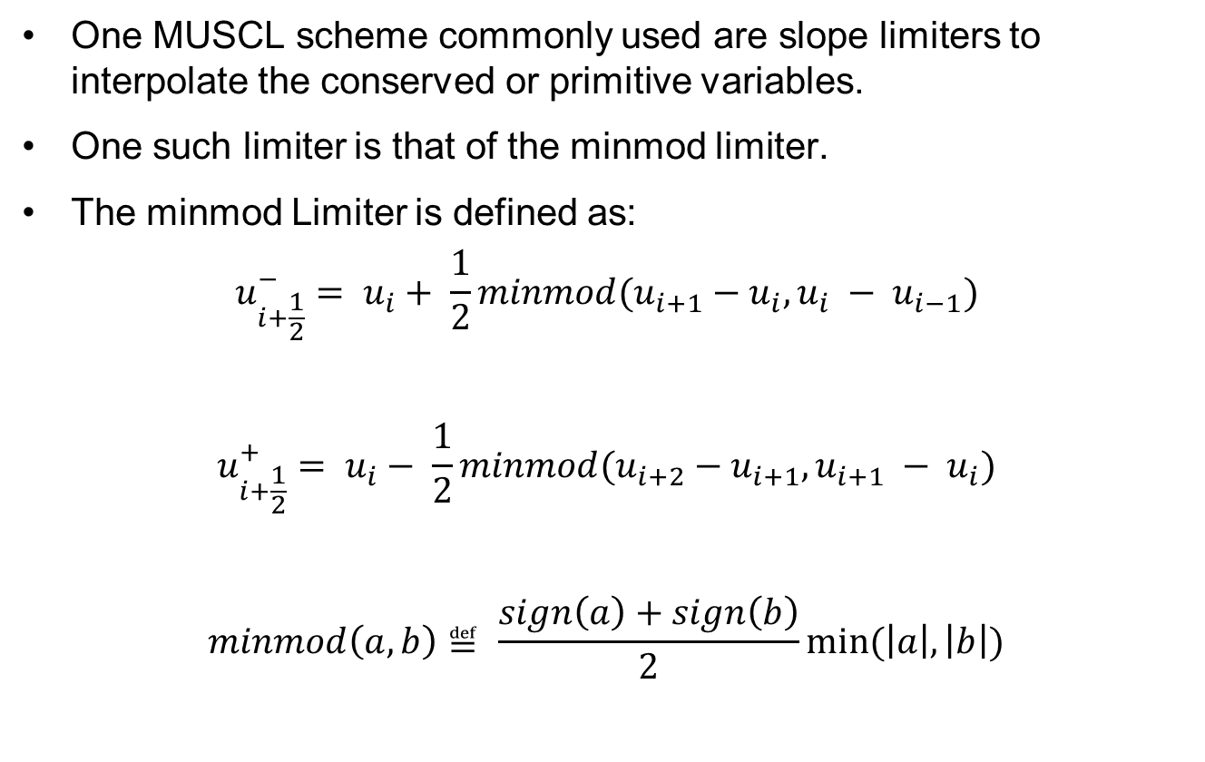
Minmod Limiter
One MUSCL scheme commonly used are slope limiters to interpolate the conserved or primitive variables.
One such limiter is that of the minmod limiter.
The minmod Limiter is defined as:
$$u_{i+\frac{1}{2}}^{−}= u_{i}+ \frac{1}{2}minmod(u_{i+1}−u_{i}, u_{i} − u_{i−1})$$
$$u_{i+\frac{1}{2}}^{+}= u_{i}− \frac{1}{2}minmod(u_{i+2}−u_{i+1}, u_{i+1} − u_{i})$$
$$minmod\left(a,b\right)≝ \frac{sign\left(a\right)+sign\left(b\right)}{2}min⁡(\left|a\right|, \left|b\right|)$$

Slide 49
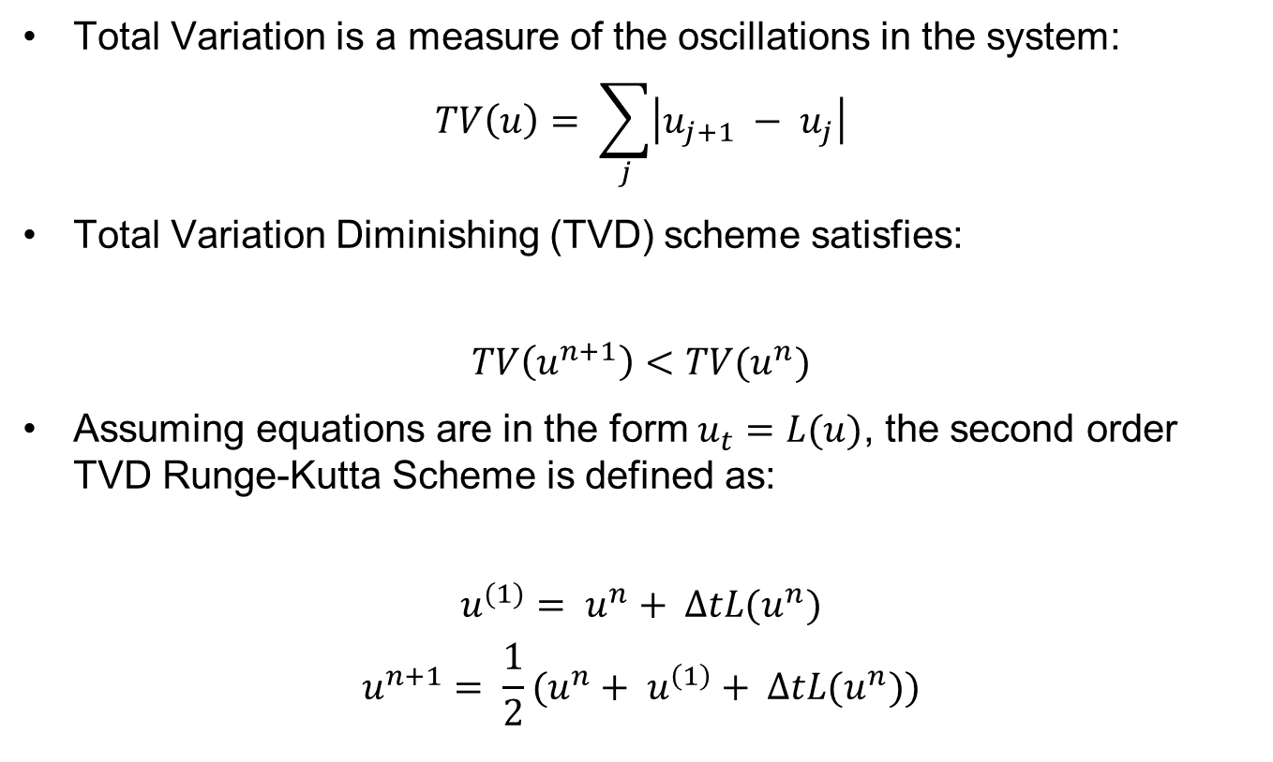
Total Variation Diminishing Scheme
Total Variation is a measure of the oscillations in the system:
$$TV\left(u\right)= \sum_{j}{\left|u_{j+1} − u_{j}\right|}$$
Total Variation Diminishing (TVD) scheme satisfies:
$$TV\left(u^{n+1}\right)<TV(u^{n})$$
Assuming equations are in the form $u_{t}=L(u)$, the second order TVD Runge-Kutta Scheme is defined as:
$$u^{(1)}= u^{n}+ ∆tL(u^{n})$$
$$u^{n+1}= \frac{1}{2}(u^{n}+ u^{\left(1\right)}+ ∆tL(u^{n}))$$

Slide 50

Resistive Flux
The flux terms for the resistive MHD are given by:
$$F_{e}^{res}= \frac{c}{2}ηJ_{i,j,k+\frac{1}{2}}^{x}\left(B_{i,j,k+1}^{y}+ B_{i,j,k}^{y}\right)− \frac{c}{2}ηJ_{i,j,k+\frac{1}{2}}^{y}(B_{i,j,k+1}^{x}+ B_{i,j,k}^{x})$$
$$F_{bx}^{res}=−cηJ_{i,j,k+1/2}^{y}$$
$$F_{by}^{res}=cηJ_{i,j,k+1/2}^{x}$$
$$F_{bz}^{res}=0$$

